Slide 1
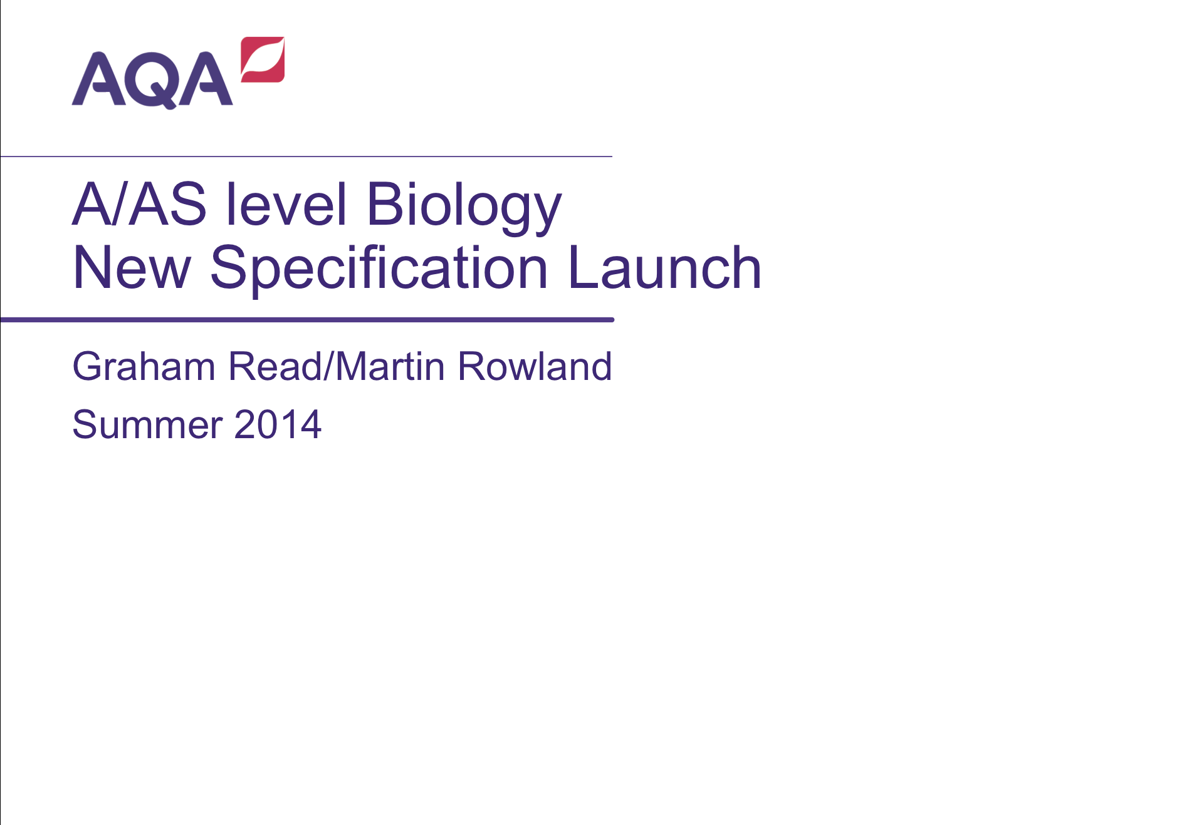
A/AS level Biology
New Specification Launch
Graham Read/Martin Rowland
Summer 2014
Follow us on Twitter @AQACPD.

Slide 2
Structure of the session
Overview of the new AS and A-level specifications
Underlying principles and key features
Specifications at a glance
Summary of content and assessment objectives
A-level Papers 1, 2 and 3 and practical assessment
Core content
The question papers and question types
Practical skills and endorsement
AS assessment
Support and resources
Slide 2
Copyright © AQA and its licensors. All rights reserved.
Follow us on Twitter @AQACPD.

Slide 3
Rules for all Science A-level from 2015
Minor changes to the subject content
AS will be a stand-alone qualification
Both AS and A-level are linear courses
AS exams at the current standard of the current AS
A-level exams at the standard of the full A-level currently
Minimum assessment time
 | AS | A-level
Assessment time | 3 hours | 6 hours
Maximum number of timetable slots | 2 | 3
Coursework/controlled assessment? | No | No
Practical endorsement | No | Yes
Practical based marks | - | 15%
Maths (Higher tier GCSE) marks | 10%(B), 20%(C), 40%(P)
Slide 3
Copyright © AQA and its licensors. All rights reserved.

Slide 4
AQA’s response to the new rules
A-level
specification content has only minor changes
assessment is in three papers, each of two hours
practical skills assessment is mainly in Paper 3
AS
assessment is in two papers, each of 1.5 hours
course designed to be co-taught in the first year of the A-level course
Slide 4
Copyright © AQA and its licensors. All rights reserved.

Slide 5
Assessment Objectives
AO1: Demonstrate knowledge and understanding of scientific ideas, processes, techniques and procedures.
AO2 Apply knowledge and understanding of scientific ideas, processes, techniques and procedures:
  in a range of theoretical and practical contexts;
  when handling qualitative and quantitative data, to solve scientific problems.
AO3 Note – no longer ‘How Science Works’
Analyse, interpret and evaluate scientific information, ideas and evidence, including in relation to issues, to:
  Make judgements and reach conclusions
  Develop and refine practical design and procedures
Slide 5

Slide 6
Context
Developed by an experienced team of teachers and examiners.
Guided by feedback from teachers and HE.
Designed to engage young people in this subject and provide effective assessments across the ability range.
Designed to prepare young people for further study and employment.
Submitted to Ofqual for accreditation. Approval expected by autumn 2014.
Assuming approval, the new AS and A-level specifications are for teaching from September 2015 with first AS assessment in summer 2016 and the first A-level assessment in summer 2017.
Slide 6
Copyright © AQA and its licensors. All rights reserved.

Slide 7
Teacher and university led design
Feedback from teachers and HE panel
Concept testing
teachers
Market testing and heads of science meetings
Draft models
Possible models
“Final” model
Student and teacher testing
HE panel
HE panel
Slide 7
Copyright © AQA and its licensors. All rights reserved.

Slide 8
AS and A-level specifications at a glance
Mainly the same content as before with, some minor, but significant, changes to content based on teacher feedback.
12 required practicals at A-level will be given in the specification.
The first 6 are the same as the required practicals for the AS.
Carrying out the required practicals will cover the basic apparatus and techniques all students must use now for any board.
Some questions in the written papers will be based on the required practicals.
These and other practicals will form the basis of the practical endorsement.
The specification will be supported with a ‘Practical Handbook’ for teaching, and also guidance for students to document their practicals.
Slide 8
Copyright © AQA and its licensors. All rights reserved.

Slide 9
A-level: assessment at a glance
Three written papers
Paper 1 | 35% | 2 hours 91 marks
Paper 2 | 35% | 2 hours 91 marks
Paper 3 | 30% | 2 hours 78 marks
Slide 9
Copyright © AQA and its licensors. All rights reserved.

Slide 10
A-level assessment in more detail
Paper 1 | + | Paper 2 | + | Paper 3
Content Biological molecules Cells Exchange and transport Biodiversity |  | Content Energy transfers in and between organisms Organisms respond to changes in their internal and external environment Genetics, populations and evolution systems Control of gene expression |  | Content All content All practical skills Essay
Questions 76 marks: mixture of short and long answer questions 15 marks extended response questions |  | Questions 76 marks: mixture of short and long answer questions 15 marks: comprehension question |  | Questions 38 marks: structured questions, including practical techniques 15 marks: critical analysis of given experimental data 25 marks: one essay from a choice of two titles
Slide 10
Copyright © AQA and its licensors. All rights reserved.

Slide 11
AS level assessment at a glance
Two written papers
Paper 1 | 50% | 1 hour 30 mins 75 marks
Paper 2 | 50% | 1 hour 30 mins 75 marks
Slide 11
Copyright © AQA and its licensors. All rights reserved.

Slide 12
AS level assessment in more detail
Paper 1 | + | Paper 2
Content Biological molecules Cells Exchange and transport Biodiversity |  | Content Biological molecules Cells Exchange and transport Biodiversity
Questions 65 marks: short answer questions 10 marks: comprehension question Some questions testing practical skills and contexts |  | Questions 65 marks: short answer questions 10 marks: structured free response Some questions testing practical skills and contexts
Slide 12
Copyright © AQA and its licensors. All rights reserved.

Slide 13
Significant changes to the specification
Reorganised some topics to give a more logical running order (for example carbohydrates, cells, DNA and protein synthesis).
Removed the ‘biology and health’ emphasis – with a shift to a more conceptual approach.
Reduced time that needs to be spent teaching specific examples (present examples such as cholera may still be used as applications in exams).
Reduced overlap with GCSE, ensuring better progression (for example - added ADH and control of blood water potential, more detail of digestion and changes to nutrient cycles).
Updated some areas, with reduction in required examples/processes
- example, the control of gene expression and genetic engineering.
Mathematical skills – 10% of marks now require the use of mathematical skills.
Slide 13
Copyright © AQA and its licensors. All rights reserved.

Slide 14
Why choose AQA’s AS and A-level specifications?
Relevant in the classroom
We have worked with many teachers from a wide range of schools and colleges in developing our A-level Biology specification.
Relevant in the real world
Our specification has been designed after consultation with representatives from universities, medical schools and industry – responses to what they want.
A fresh approach that suits you
Our fresh conceptual approach to Biology allows you to teach concepts/important ideas and then choose the context and application that will most interest your students – perhaps things now in the news.
Practicals at the heart of science
Biology is an experimental subject. This specification provides many opportunities to use practical experiences to link theory to reality, and to equip students with the essential practical skills they need.
Slide 14
Copyright © AQA and its licensors. All rights reserved.

Slide 15
Resources to help you plan, teach and assess
Launch events: both online and face to face
Prepare to teach events
Specimen materials (x2)
Questions
Schemes of work (x2)
Printed specifications
Progression and switching information
3 textbook publishers
Bridging information from Nelson Thornes books
Slide 15
Copyright © AQA and its licensors. All rights reserved.

Slide 16
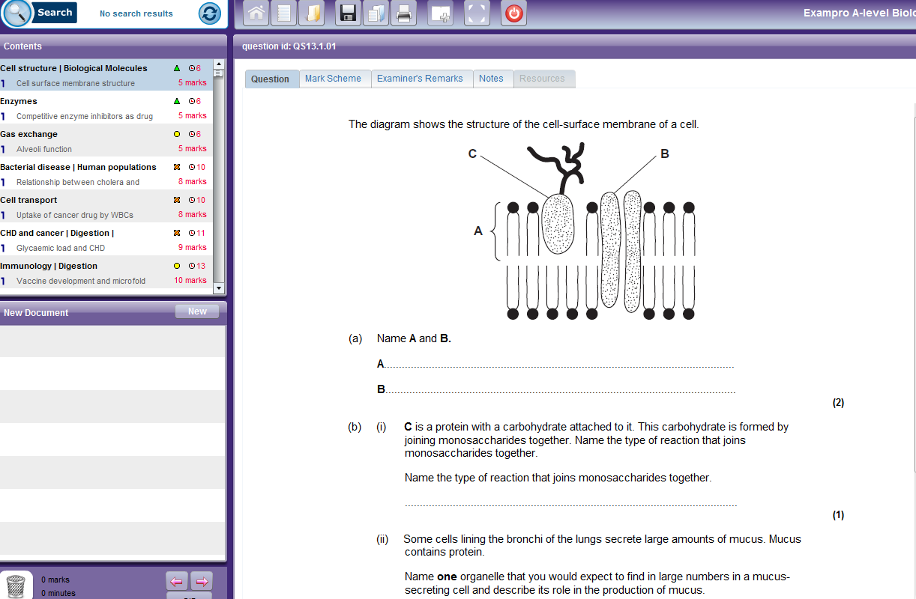
Exampro – option to buy additional resources
Cost: £80 - every licence includes three concurrent users so any three teachers can use each database simultaneously but you can order additional users at any time.
Slide 16
Copyright © AQA and its licensors. All rights reserved.

Slide 17
Textbooks
The following textbooks by Oxford University Press, Hodder Education and Collins have been selected to enter the AQA approval process for A-level Biology. Upon successful completion of the process, the books will be published as ‘AQA approved’.
Full details of our approval process and links to these titles will be on our website later this year.
AS Biology for AQA Student Book | Oxford University Press
A-level Biology for AQA Student Book | Oxford University Press
AQA A-level Biology Year 1 Student Book | Hodder Education
AQA A-level Biology Year 2 Student Book | Hodder Education
AQA A-level Biology Student Book 1 | Collins
AQA A-level Biology Student Book 2 | Collins
Slide 17
Copyright © AQA and its licensors. All rights reserved.
Copyright © AQA and its licensors. All rights reserved.

Slide 18
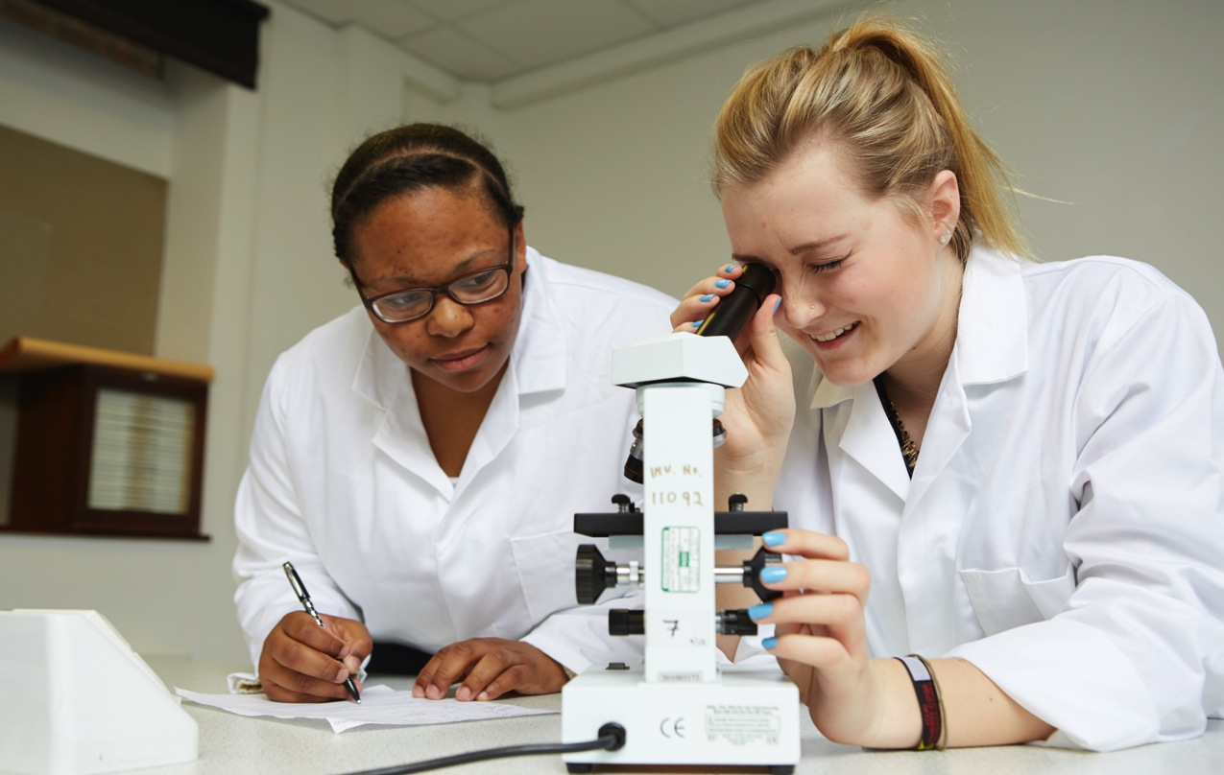
Required practical activities
Slide 18
Copyright © AQA and its licensors. All rights reserved.
Copyright © AQA and its licensors. All rights reserved.

Slide 19
Required practical activities
Slide 19
Copyright © AQA and its licensors. All rights reserved.
Copyright © AQA and its licensors. All rights reserved.

Slide 20
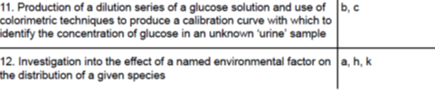
Required practical activities - continued
Slide 20
Copyright © AQA and its licensors. All rights reserved.
Copyright © AQA and its licensors. All rights reserved.

Slide 21
5 Competencies – common to all boards
Follows written procedures
Applies investigative approaches and methods when using instruments and equipment
Safely uses a range of practical equipment and materials
Makes and records observations
Researches, references and reports
Slide 21

Slide 22
Endorsement – all boards
Competencies (Common Practical Assessment Criteria) – assessed by the teacher for endorsement
  Pass or not reported
Consistency - details of administration will be common to all boards
AQA is very aware that record keeping and moderation needs to be a workable process, that is not onerous on schools
Awarding bodies have made recommendations to Ofqual and boards will be running trials in the autumn term, could involve:
  monitoring teaching plans/student logs
  monitoring teacher assessment
  student interviews
Final details due Spring 2015. Make sure you’re using the final version of the specifications.
Slide 22

Slide 23

Questions
Slide 23
Copyright © AQA and its licensors. All rights reserved.

Slide 24

Exemplars
Slide 24
Copyright © AQA and its licensors. All rights reserved.

Slide 25
Question structure – 1, structured short answer
As in current papers – structured, free response, short answer questions.
Can students tell us what they know about/or explain about something they have been taught?
Paper 1, question 11 - structured free response
Look at the part 1 of this question. What is required?*
Note, some of these questions can be ‘Explain’.
What would you write about if asked to, ‘Explain the importance of mRNA in protein synthesis.’ ?**
Slide 25
Copyright © AQA and its licensors. All rights reserved.

Slide 26
Question structure – 2, questions based on comprehension
As in present specification, questions based upon applying what students know to a comprehension passage - usually a substantial synoptic requirement
Can students apply what they know to a written context?
Paper 2, question 10, questions based on a comprehension passage
Modern context – a ‘coming’ topic in medicine and research.
What A-level knowledge is required to understand properly the contents of this passage?*
Slide 26
Copyright © AQA and its licensors. All rights reserved.

Slide 27
Time for a break
Slide 27

Slide 28
Question structure – 3, the essay as a synoptic exercise
As in present Paper 5, a free response essay addressing a theme in a title, with a choice from two titles.
Can students bring together material from a range of topics to illustrate and explain an important concept/idea?
Paper 3, question 6
Essay will be marked in a similar way to current papers but without separate breadth, relevance, or QWC marks.*
‘Levels’ descriptors – used with detailed guidelines to achieve suitable mark.
The importance of receptors in living organisms.
What could be the theme of the essay?**
What might be suitable topic areas?***
Slide 28
Copyright © AQA and its licensors. All rights reserved.

Slide 29
Question structure – 4, questions examining work of scientists
As in present papers – questions with novel contexts drawn from real life and real research – most notably the 15 mark question in Paper 5.
Can students apply their A-level knowledge and understanding of practical skills/scientific working to a novel context?
Paper 3, question 5 (15 marks) based on published work of scientists and new content
What aspects of practical skills are tested here?*
Slide 29
Copyright © AQA and its licensors. All rights reserved.

Slide 30
New content exemplar -1
Paper 2, question 3, gene linkage
GCSE has monohybrid crosses.
Understanding of linkage tied to understanding of relationships between alleles, genes, homologous chromosomes and meiosis – synoptic.
Includes understanding of stats test requirements – not mechanics of how to do.
Suggestions as to why we’ve gone for this approach to stats?*
Slide 30
Copyright © AQA and its licensors. All rights reserved.

Slide 31
New content exemplar - 2
Paper 2, question 7, ADH and water re-absorption
Many teachers expressed concern that we ‘dropped the kidney’ in the previous specification.
As a topic, it gives many opportunities to develop synoptic understanding, building on topics studied in earlier Sections.
Which synoptic topics from earlier Sections provide knowledge and understanding required to study the role of ADH in the kidney?*
Slide 31
Copyright © AQA and its licensors. All rights reserved.

Slide 32
Set practical exemplar
Paper 1, question 1, based on one of the set practicals from the specification
Section 3.1.4.2. Investigation into the effect of a named variable on the rate of reaction of an enzyme-controlled reaction.
What skills are tested here?*
Slide 32
Copyright © AQA and its licensors. All rights reserved.

Slide 33
AS Papers
Very similar to present AS and same styles of questions as current AS.
Based on content of Sections 1 to 4.
Note – content and ideas from these Sections may be tested at A-level standard in A-level Papers 1, 2 and 3. Therefore Paper 1 for A-level will not consist of AS questions – though some overlap in levels and styles of questions.
Ofqual require this approach for the new, linear A-levels.
Slide 33
Copyright © AQA and its licensors. All rights reserved.

Slide 34
AS Papers – types of question
Very similar/same styles as in A-level papers.
Paper 1, question 9 - comprehension and associated questions.
Paper 2, question 10 - structured free response.
Paper 1, questions 1, 2 and 8 - knowledge of aspects of practical skills tested, (also questions in Paper 2).
Paper 2, question 4 - application of knowledge.
Paper 2, questions 1, 2 and 4 - use of maths skills.
Slide 34
Copyright © AQA and its licensors. All rights reserved.

Slide 35
Questions
Slide 35
Copyright © AQA and its licensors. All rights reserved.

Slide 36

AQA ongoing support and resources
AQA website
e-AQA
Secure Key Materials
ERA (Enhanced Results Analysis)
Training courses
Preparing to teach events
Slide 36
Copyright © AQA and its licensors. All rights reserved.

Slide 37
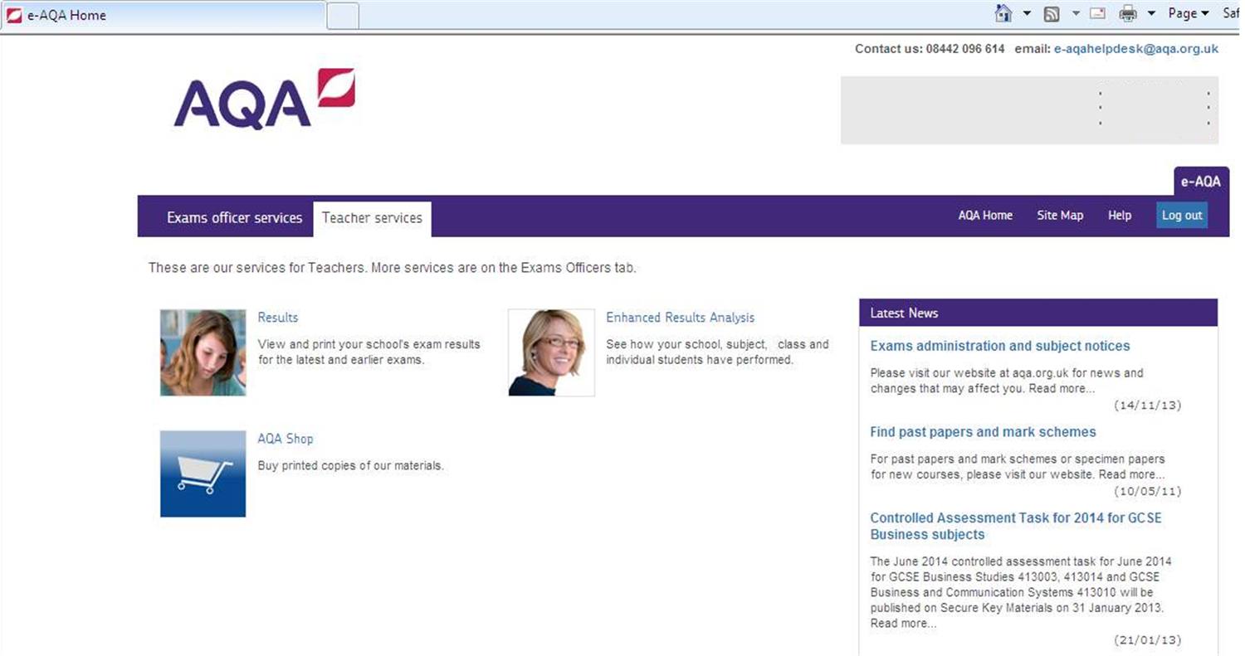
e-AQA
Slide 37
Copyright © AQA and its licensors. All rights reserved.

Slide 38
Timeline 1
Draft Specification and specimen question papers, and mark schemes published
First teaching of AS/A-level in Biology
Accredited Specification published
Teacher training courses available
Free Preparing to Teach events online and face to face
Free Introductory events online
and face to face
Teacher and learner resources published
Jun 14
Sep14
Dec 14
Mar 14
Jun 15
Sep15
Slide 38
Copyright © AQA and its licensors. All rights reserved.
Copyright © AQA and its licensors. All rights reserved.

Slide 39
Final questions
Slide 39
Copyright © AQA and its licensors. All rights reserved.
Follow us on Twitter @AQACPD.

Slide 40
Contact points for more information and guidance
For further questions contact our Customer Support Managers
Contact details for A-level Science:
science-gce@aqa.org.uk
Tel no: 01483 477756
Slide 40
Copyright © AQA and its licensors. All rights reserved.

Slide 41
Thank you
We are an independent education charity
and the largest provider of academic qualifications for all abilities taught in schools and colleges.
Our aim is to enable students to realise their potential
and provide teachers with the support and resources they need
so that they can focus on inspiring learning.
aqa.org.uk
Follow us on Twitter @AQACPD.

