Slide 1
AS and A-level Chemistry
For first teaching in 2015
John Bentham/Graham Curtis
Summer 2014
Follow us on Twitter @AQACPD.

Slide 2
Structure of the session
Overview of the new AS and A-level specifications
Underlying principles and key features
Specifications at a glance
Summary of content and assessment objectives
A-level Papers 1, 2 and 3 and practical assessment
Core content
The question papers and question types
Practical skills and endorsement
Break
Assessment exemplars
Support and resources
Slide 2
Copyright © AQA and its licensors. All rights reserved.
Follow us on Twitter @AQACPD.

Slide 3
Rules for all Science A-levels from 2015
Both AS and A-level are linear courses
AS will be a stand-alone qualification
A-level exams at the standard of the full A-level currently
 | AS | A-level
Minimum assessment time | 3 hours | 6 hours
Maximum number of timetable slots | 2 | 3
Coursework/controlled assessment? | No | No
Practical endorsement | No | Yes
Practical based marks | - | 15%
Maths (Higher tier GCSE) marks | 20%(C),10%(B),40%(P)
Slide 3

Slide 4
AQA’s response to the new rules
A-level
specification content has only minor changes
assessment is in three papers, each of two hours
practical skills assessment is mainly in Paper 3
AS
assessment is in two papers, each of 1.5 hours
course designed to be co-taught in the first year of the A-level course
Slide 4
Copyright © AQA and its licensors. All rights reserved.

Slide 5
Context
Developed by an experienced team of teachers and examiners.
Designed to engage young people in this subject and provide effective assessments across the ability range.
Submitted to Ofqual for accreditation. Approval expected by Autumn 2014.
Assuming approval, the new AS and A-level specifications are for teaching from September 2015 with first AS assessment in summer 2016 and the first A-level assessment in summer 2017.
Slide 5
Copyright © AQA and its licensors. All rights reserved.

Slide 6
Teacher and university led design
Feedback from teachers and HE panel
Concept testing
teachers
Market testing and heads of science meetings
Draft models
Possible models
“Final” model
Student and teacher testing
HE panel
HE panel
Slide 6
Copyright © AQA and its licensors. All rights reserved.

Slide 7
AS and A-level specifications at a glance
Mainly the same content as before with, some minor, but significant, changes to content based on teacher feedback.
Re-arranged in the traditional three branches of physical, inorganic and organic chemistry.
12 required practicals at A-level will be given in the specification.
The first 6 are the same as the required practicals for AS.
Carrying out the required practicals will cover the basic apparatus and techniques all students must use now for any board.
Some questions in the written papers will be based on the required practicals.
These and other practicals will form the basis of the practical endorsement.
The specification will be supported with a ‘Practical Handbook’ for teaching, and also guidance for students to document their practicals.
Slide 7
Copyright © AQA and its licensors. All rights reserved.

Slide 8
A-level: assessment at a glance
Three written papers
Paper 1 | 35% | 2 hours 105 marks
Paper 2 | 35% | 2 hours 105 marks
Paper 3 | 30% | 2 hours 90 marks
Slide 8
Copyright © AQA and its licensors. All rights reserved.

Slide 9
A-level assessment in more detail
Paper 1: Inorganic and Physical chemistry | + | Paper 2: Organic and Physical chemistry | + | Paper 3: Practical skills, data handling and synopsis
Content Inorganic chemistry Relevant practical skills Relevant physical chemistry topics eg: Atomic structure Amount of substance Bonding Energetics Equilibria Acids and bases Redox |  | Content Organic chemistry Relevant practical skills Relevant physical chemistry topics eg: Amount of substance Bonding Energetics Equilibria Kinetics |  | Content All content All practical skills
Questions 105 marks, with a mixture of short and long answer questions |  | Questions 105 marks, with a mixture of short and long answer questions |  | Questions 40 marks of questions on practical techniques and data analysis 20 marks of questions testing across the specification 30 marks of multiple choice questions
Slide 9
Copyright © AQA and its licensors. All rights reserved.

Slide 10
AS assessment at a glance
Two written papers
Paper 1 | 50% | 1 hour 30 mins 80 marks
Paper 2 | 50% | 1 hour 30 mins 80 marks
Slide 10
Copyright © AQA and its licensors. All rights reserved.

Slide 11
AS assessment in more detail
Paper 1: Inorganic and Physical chemistry | + | Paper 2: Organic and Physical chemistry
Content Inorganic chemistry Relevant practical skills Relevant physical chemistry topics eg: Atomic structure Amount of substance Bonding Energetics Equilibira Redox |  | Content Organic chemistry Relevant practical skills Relevant physical chemistry topics eg: Amount of substance Bonding Energetics Equilibria Kinetics
Questions 65 marks, with a mixture of short and long answer questions 15 marks of multiple choice questions |  | Questions 65 marks, with a mixture of short and long answer questions 15 marks of multiple choice questions
Slide 11
Copyright © AQA and its licensors. All rights reserved.

Slide 12
Assessment objectives
 |  | A-level AS
AO1 | Demonstrate knowledge and understanding of scientific ideas, processes, techniques and procedures | 30-35% (Bi/Ch/Ph) | 35-40% (Bi/Ch/Ph)
AO2 | Apply knowledge and understanding of scientific ideas, processes, techniques and procedures: in a theoretical context in a practical context when handling qualitative data when handling quantitative data | 40-45% (Bi/Ch/Ph) | 40-45% (Bi/Ch/Ph)
AO3 | Analyse, interpret and evaluate scientific information, ideas and evidence, including in relation to issues, to: make judgements and reach conclusions develop and refine practical design and procedures | 25-30% (Bi/Ch/Ph) | 20-25% (Bi/Ch/Ph)
Slide 12
Copyright © AQA and its licensors. All rights reserved.

Slide 13
Significant changes to the specification
Time of flight mass spectrometry replaces the older technique and fragmentation of molecular ions has been deleted.
Skeletal formulae for organic compounds have been included
Structure of DNA and drug action have been introduced.
Chromatography has been extended with introductions to Thin layer, Column and Gas chromatography.
Transition metal chemistry has been modified and reduced.
Metal extraction has been deleted.
Slide 13
Copyright © AQA and its licensors. All rights reserved.

Slide 14
Why choose AQA’s AS and A-level specifications?
Relevant in the classroom
We have worked with many teachers from a wide range of schools and colleges in developing our A-level Chemistry specification.
Relevant in the real world
Our specification has been designed after consultation with representatives from universities and industry.
We have also consulted with the medical profession and pharmaceutical industry as well as pure chemists.
A fresh approach that suits you
Our fresh approach to Chemistry allows you to choose the context and application that will most interest your students.
Practicals at the heart of science
Chemistry is an experimental subject. This specification provides many opportunities to use practical experiences to link theory to reality, and to equip students with the essential practical skills they need.
Slide 14
Copyright © AQA and its licensors. All rights reserved.

Slide 15
Resources to help you plan, teach and assess
Launch events: both online and face to face
Prepare to teach events
Specimen materials (x2)
Questions
Schemes of work (x2)
Printed specifications
Progression and switching information
3 textbook publishers
Bridging information from Nelson Thornes books
Glossary of command words, definitions and transition metal colours to be available on the AQA website
Slide 15
Copyright © AQA and its licensors. All rights reserved.

Slide 16
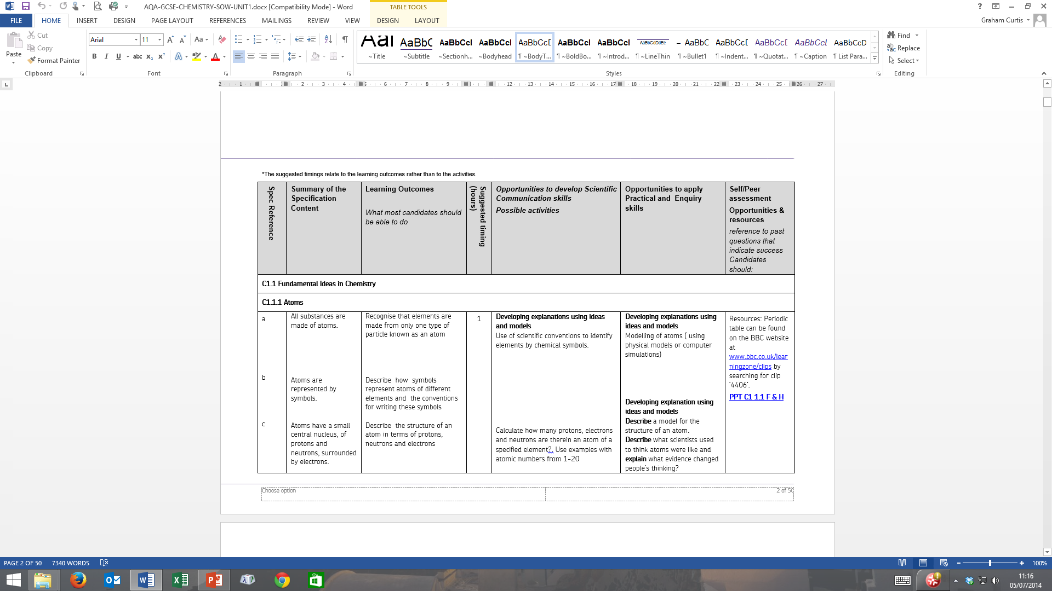
Schemes of work – such as this GCSE example
Slide 16
Copyright © AQA and its licensors. All rights reserved.

Slide 17
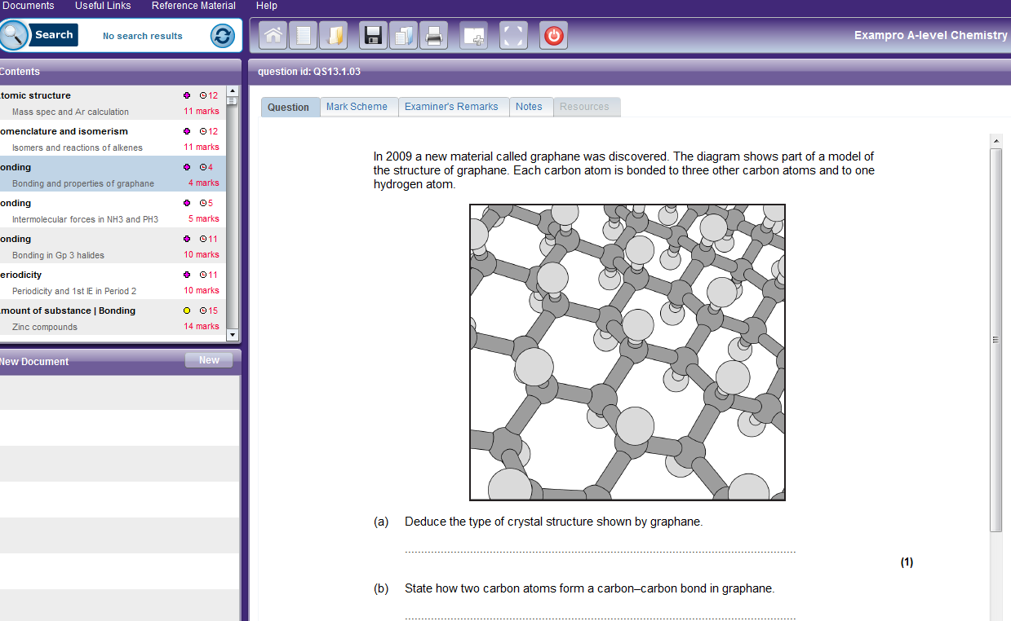
Exampro – option to buy additional resources
Cost: £80 - every licence includes three concurrent users so any three teachers can use each database simultaneously but you can order additional users at any time.
Slide 17
Copyright © AQA and its licensors. All rights reserved.

Slide 18
Textbooks
The following textbooks by Oxford University Press, Hodder Education and Collins have been selected to enter the AQA approval process for A-level Chemistry. Upon successful completion of the process, the books will be published as ‘AQA approved’.
Full details of our approval process and links to these titles will be on our website later this year.
AS Chemistry for AQA Student Book | Oxford University Press
A-level Chemistry for AQA Student Book | Oxford University Press
AQA A-level Chemistry Year 1 Student Book | Hodder Education
AQA A-level Chemistry Year 2 Student Book | Hodder Education
AQA A-level Chemistry Student Book 1 | Collins
AQA A-level Chemistry Student Book 2 | Collins
Copyright © AQA and its licensors. All rights reserved.
Slide 18
Copyright © AQA and its licensors. All rights reserved.

Slide 19
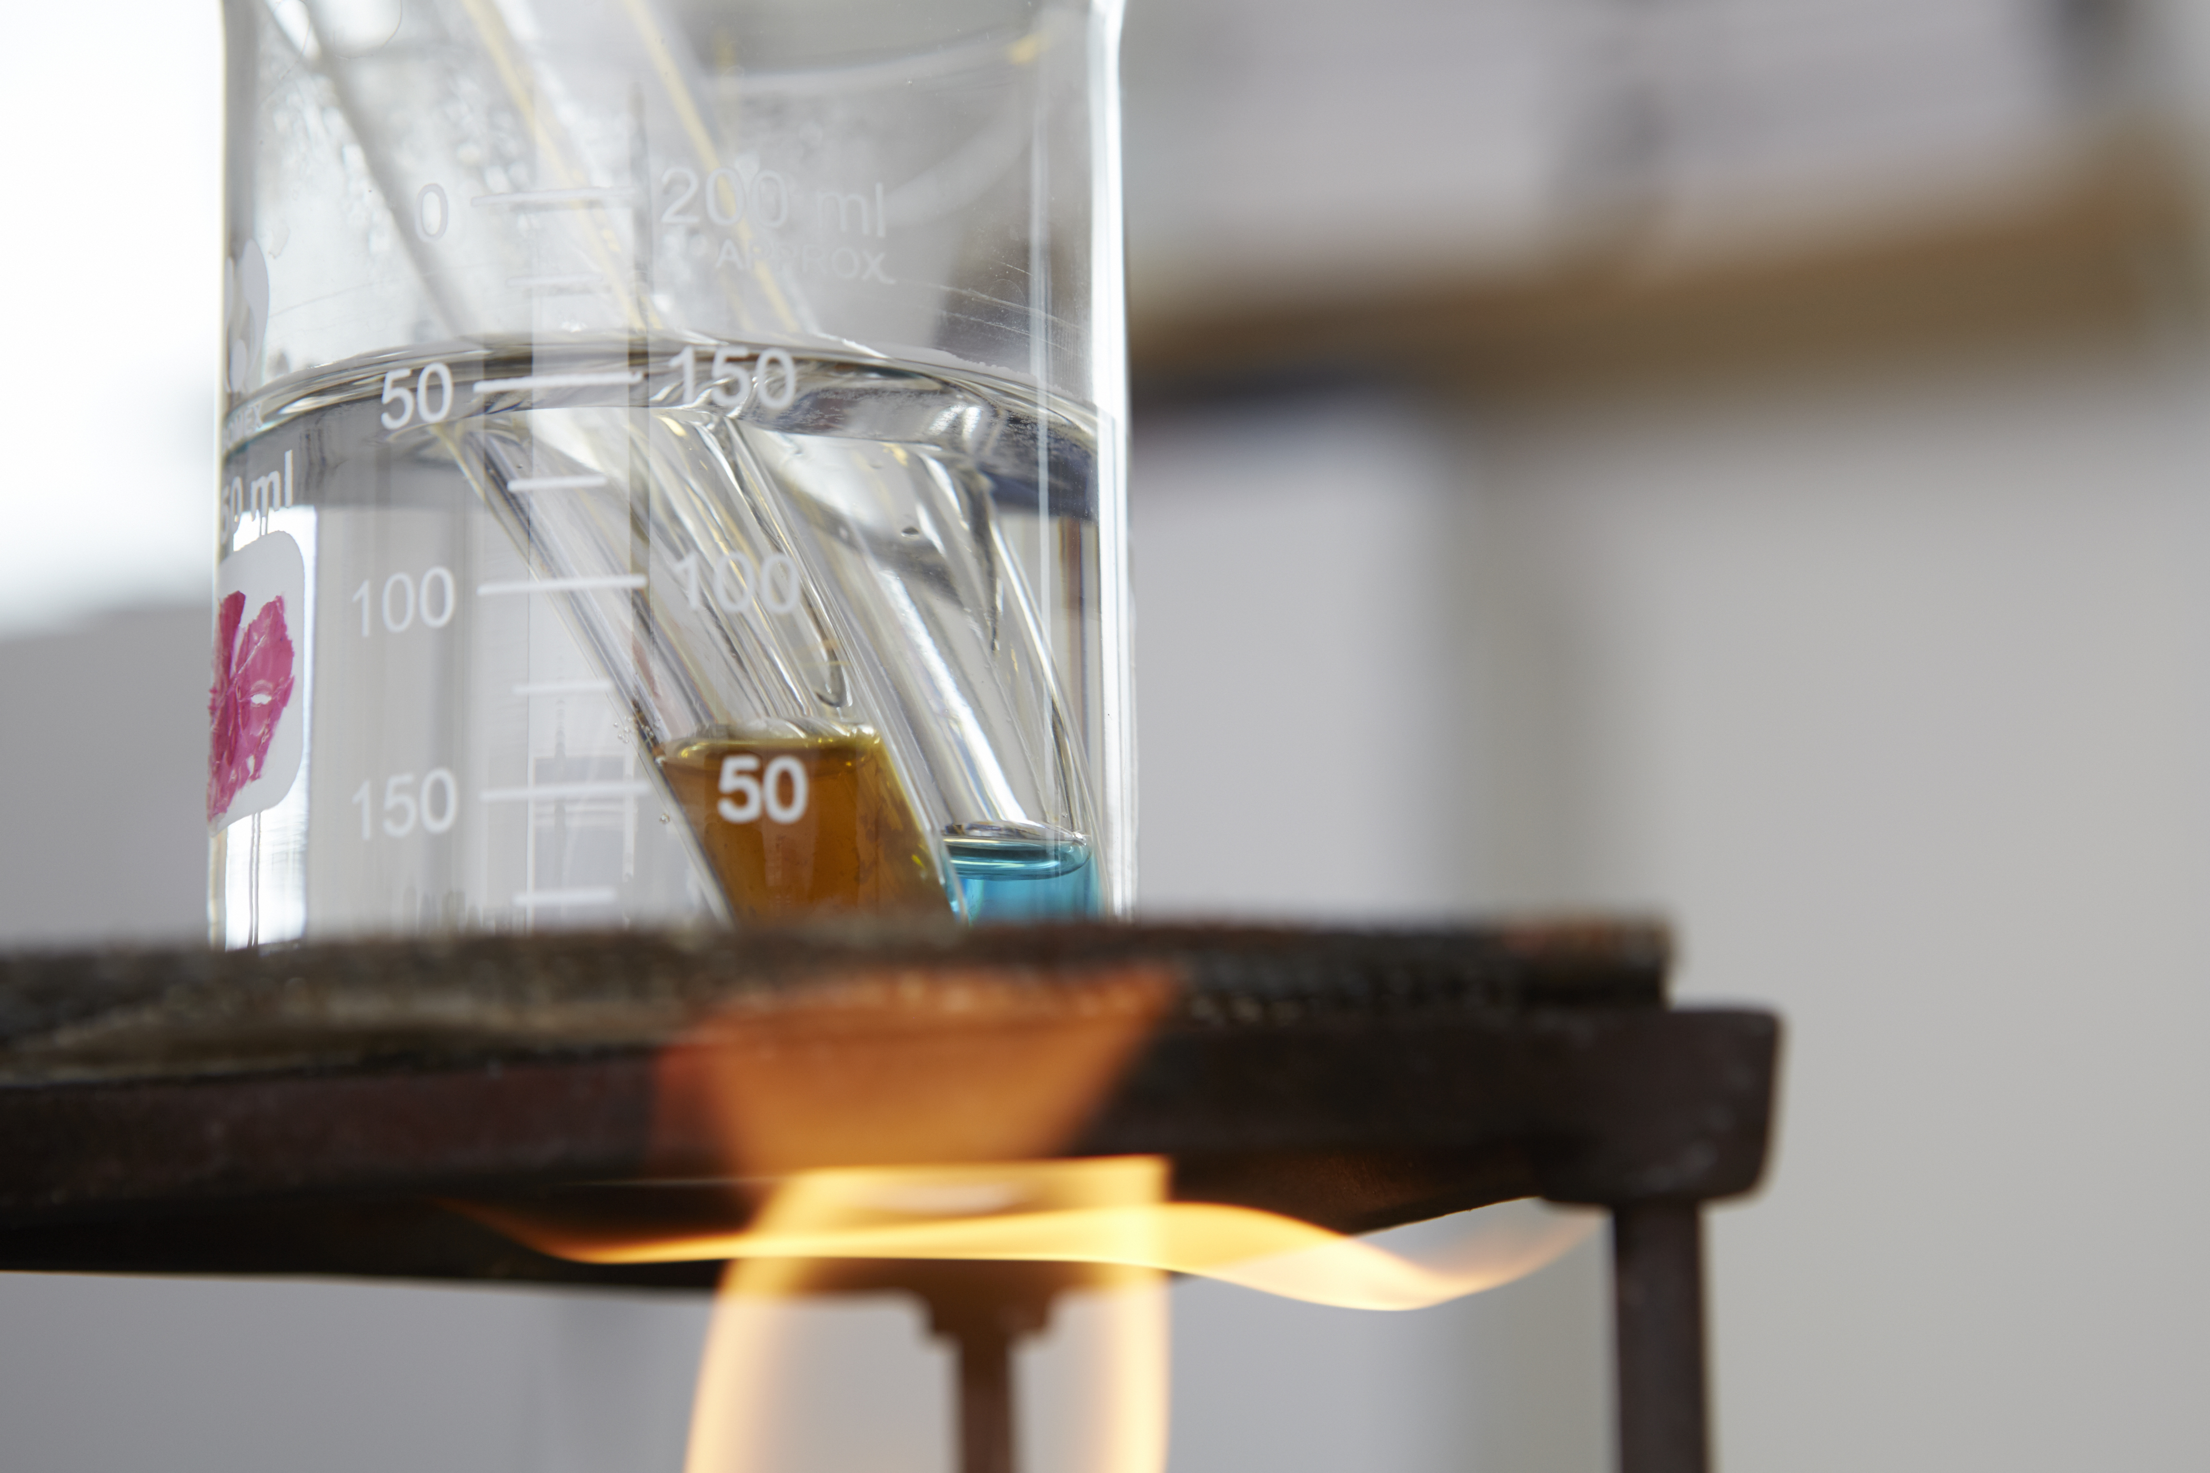
Required practical activities
Slide 19
Copyright © AQA and its licensors. All rights reserved.

Slide 20
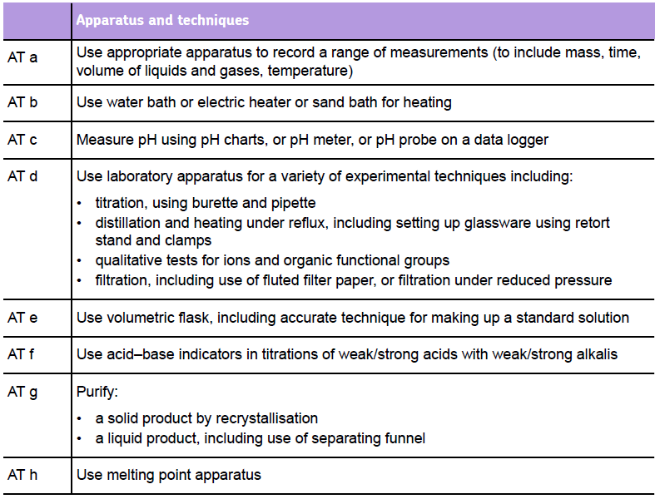
Use of apparatus and techniques
Slide 20
Copyright © AQA and its licensors. All rights reserved.

Slide 21
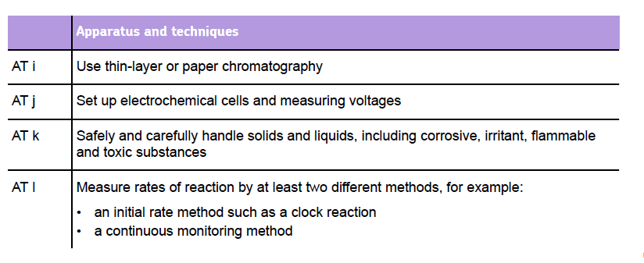
Use of apparatus and techniques
Slide 21
Copyright © AQA and its licensors. All rights reserved.

Slide 22
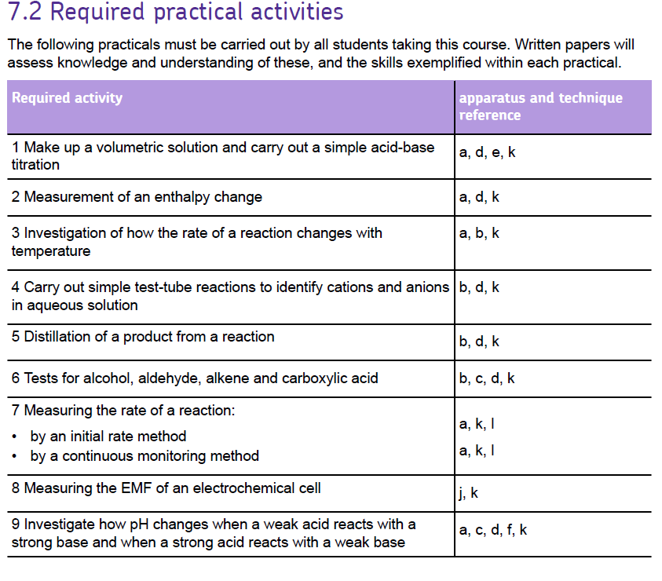
Required practical activities
Slide 22
Copyright © AQA and its licensors. All rights reserved.

Slide 23
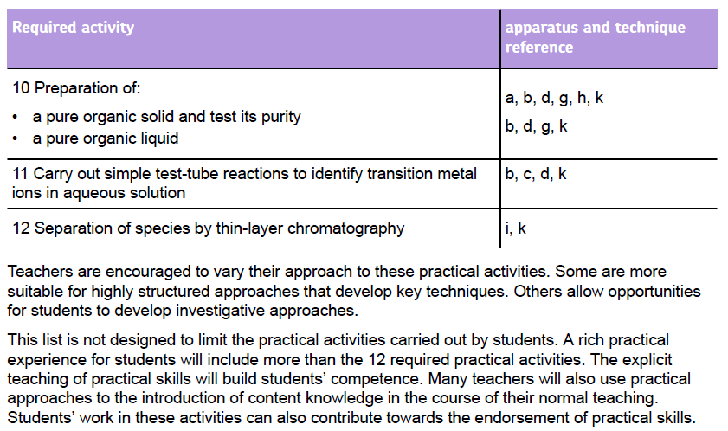
Required practical activities
Slide 23
Copyright © AQA and its licensors. All rights reserved.

Slide 24
5 Competencies – common to all boards
Follows written procedures
Applies investigative approaches and methods when using instruments and equipment
Safely uses a range of practical equipment and materials
Makes and records observations
Researches, references and reports
Slide 24

Slide 25
Endorsement – all boards
Competencies (Common Practical Assessment Criteria) – assessed by the teacher for endorsement
  Pass or not reported
Consistency - details of administration will be common to all boards
AQA is very aware that record keeping and moderation needs to be a workable process, that is not onerous on schools
Awarding bodies have made recommendations to Ofqual and boards will be running trials in the autumn term, could involve:
  monitoring teaching plans/student logs
  monitoring teacher assessment
  student interviews
Final details due Spring 2015. Make sure you’re using the final version of the specifications.
Slide 25

Slide 26

Questions
Slide 26
Copyright © AQA and its licensors. All rights reserved.

Slide 27

Slide 27

Slide 28

Exemplars
Slide 28
Copyright © AQA and its licensors. All rights reserved.

Slide 29
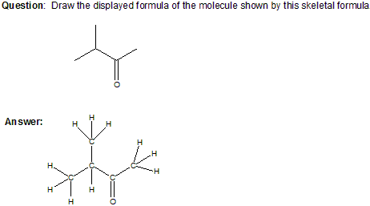
New topic exemplars – skeletal formula
Slide 29
Copyright © AQA and its licensors. All rights reserved.

Slide 30
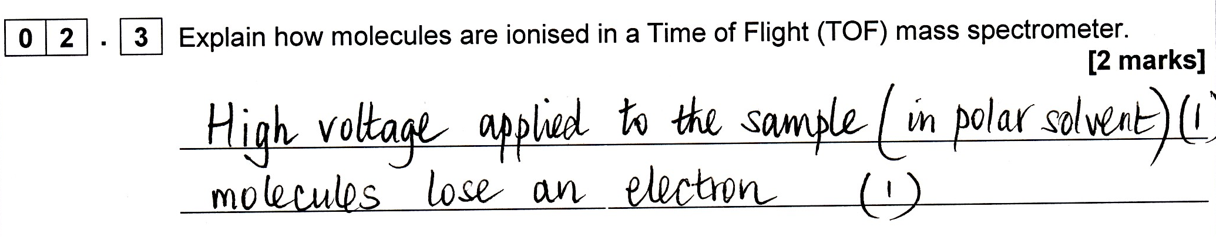
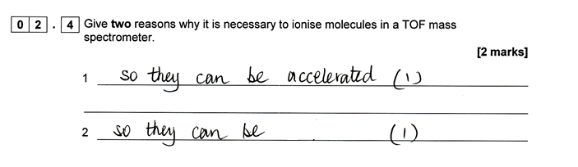
New topic exemplars – 1 (AS1)
Time of flight mass - AS Paper 1, questions 2.3 and 2.4
detected
Slide 30
Copyright © AQA and its licensors. All rights reserved.

Slide 31
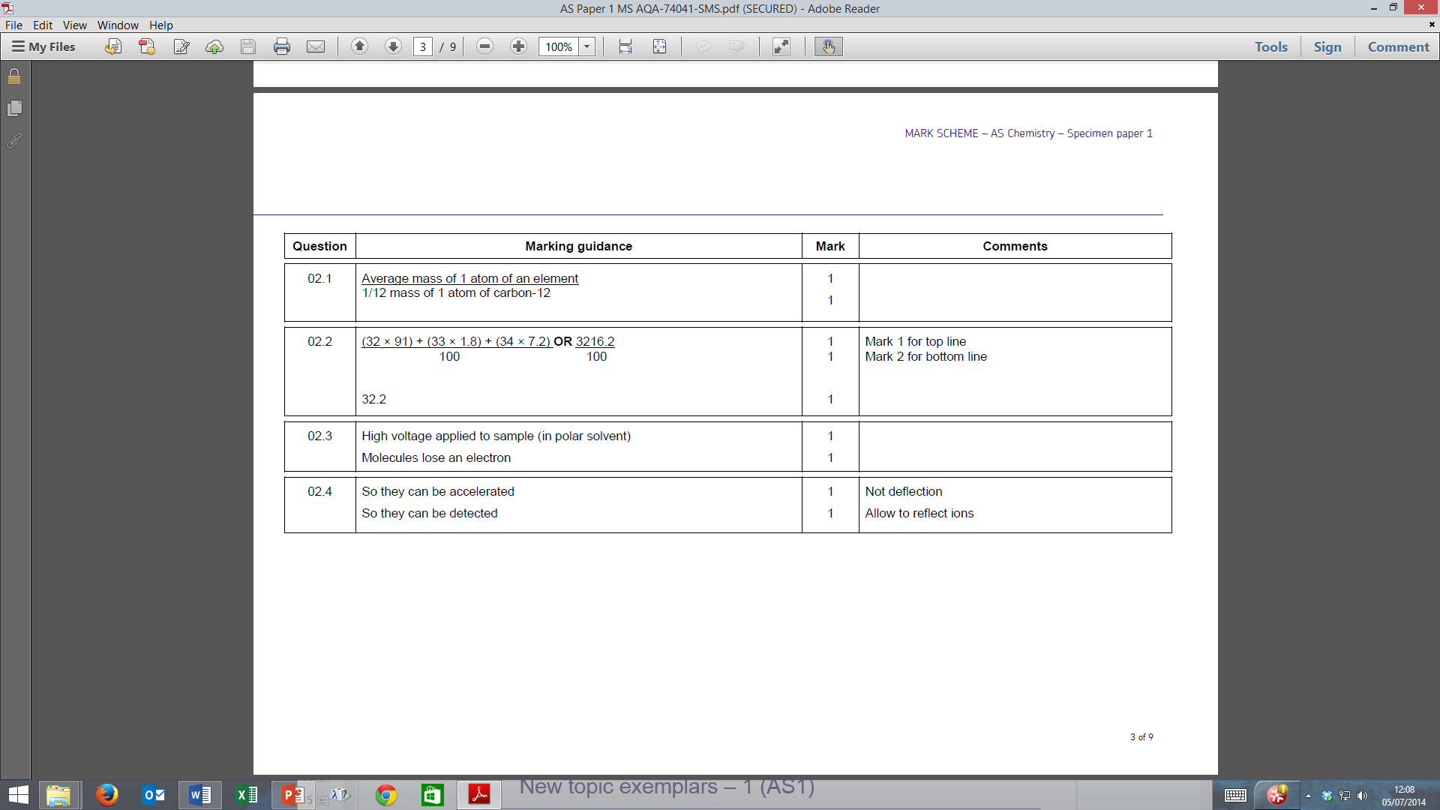
New topic exemplars – 1 (AS1)
Time of flight mass - AS Paper 1, questions 2.3 and 2.4
Slide 31
Copyright © AQA and its licensors. All rights reserved.

Slide 32
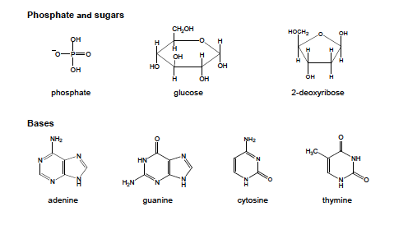
New topic – DNA and proteins - data sheet to help
Slide 32
Copyright © AQA and its licensors. All rights reserved.

Slide 33
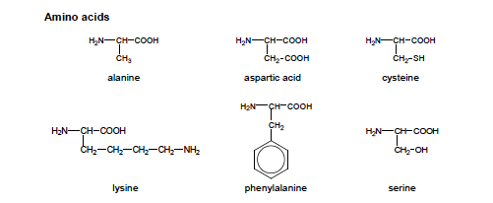
New topic – DNA and proteins - data sheet to help
Slide 33
Copyright © AQA and its licensors. All rights reserved.

Slide 34
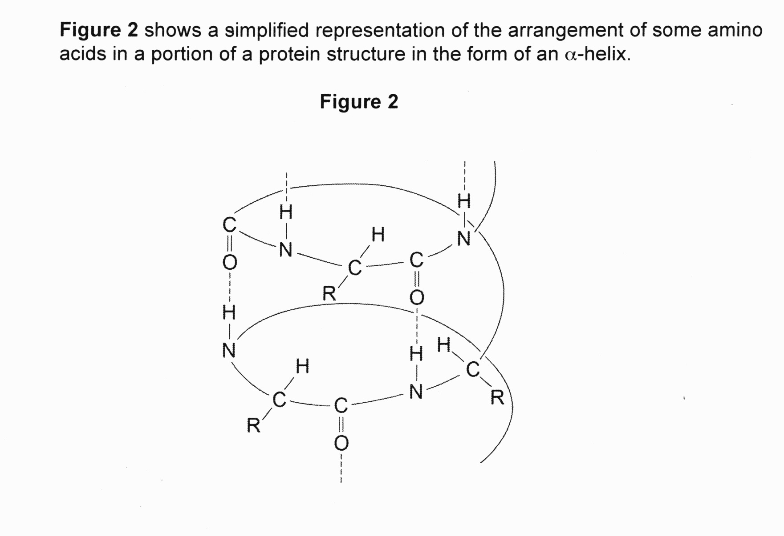
New topic exemplars – 2 (A2)
Structure of DNA and proteins - A-level Paper 2, question 5
Slide 34
Copyright © AQA and its licensors. All rights reserved.

Slide 35
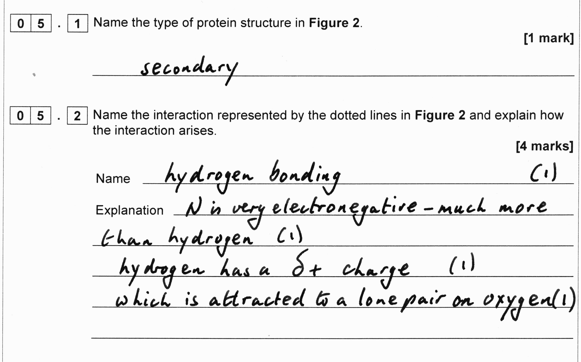
New topic exemplars – 2 (A2)
A-level Paper 2, questions 5.1 and 5.2
Slide 35
Copyright © AQA and its licensors. All rights reserved.

Slide 36
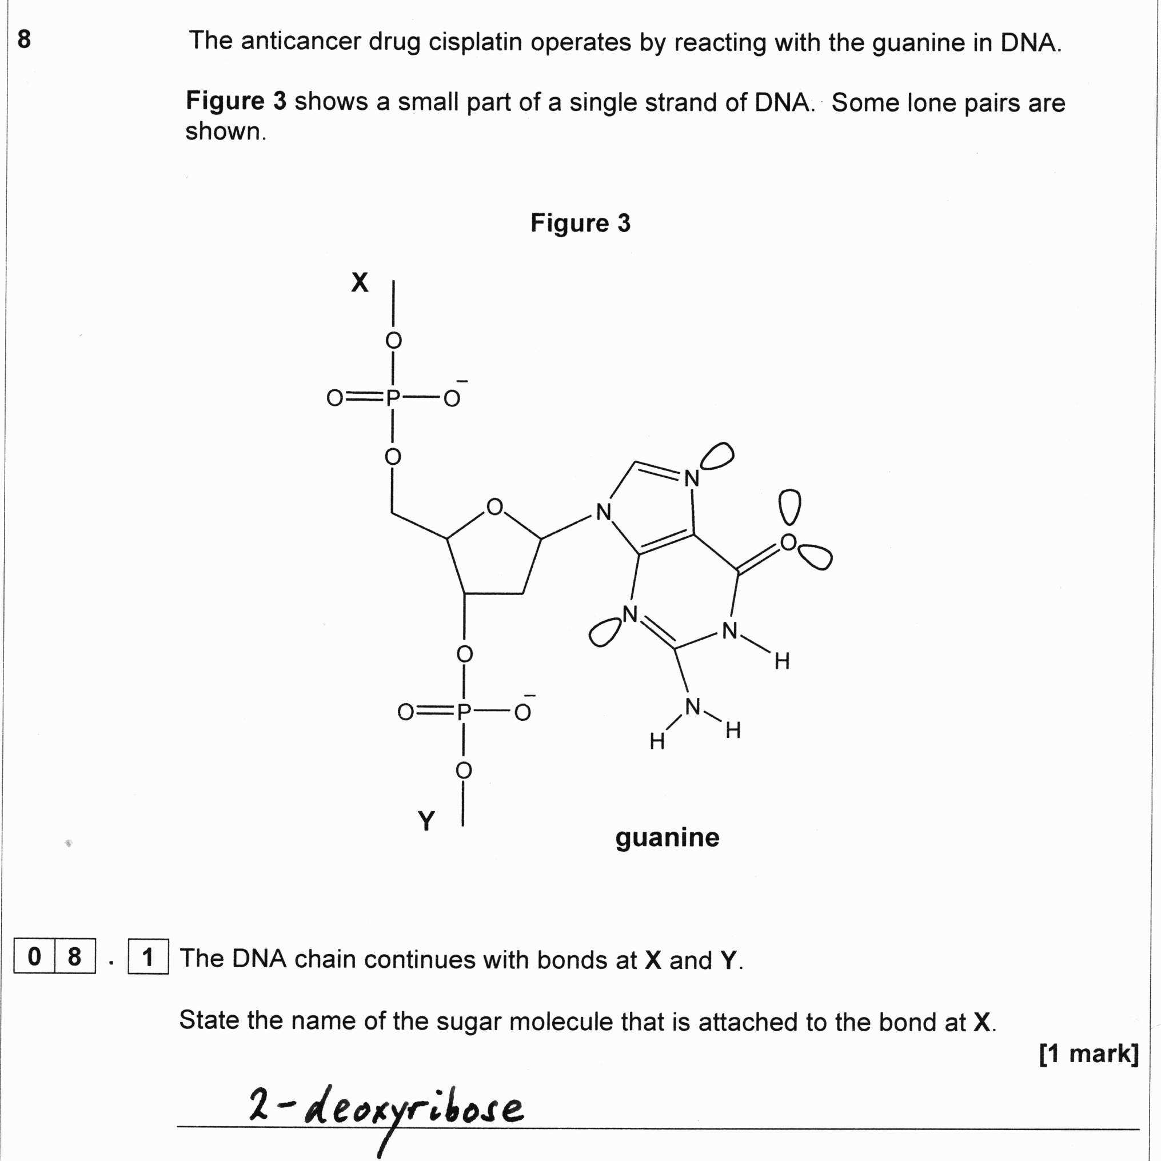
New topic exemplars – 2 (A2)
A-level Paper 2, question 8.1
Slide 36
Copyright © AQA and its licensors. All rights reserved.

Slide 37
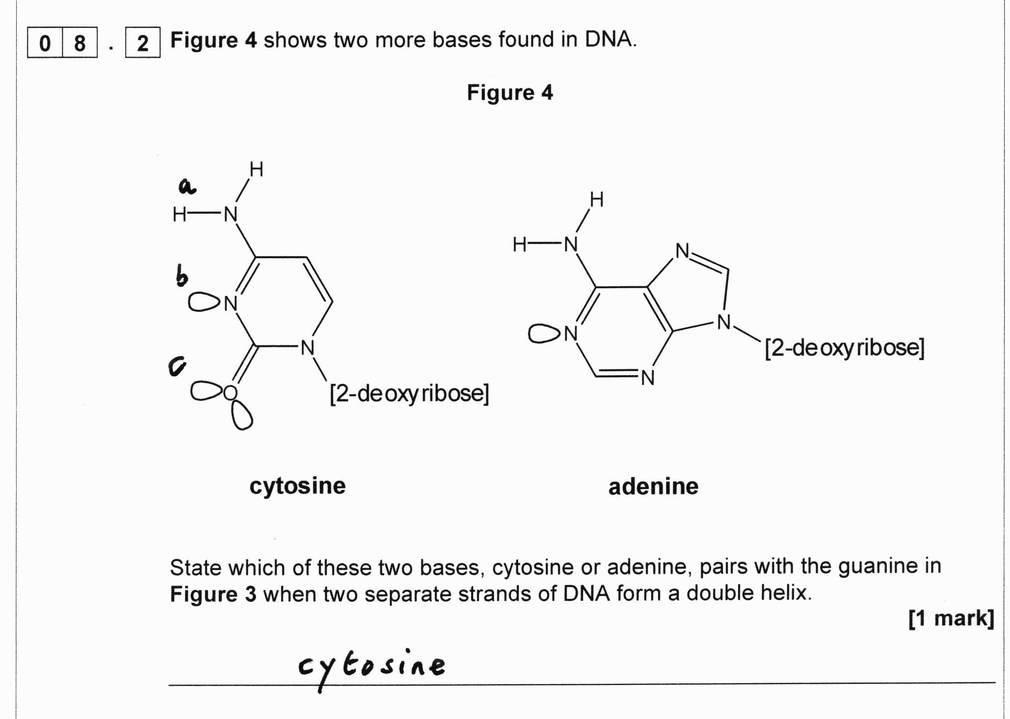
New topic exemplars – 2 (A2)
A-level Paper 2, question 8.2
Slide 37
Copyright © AQA and its licensors. All rights reserved.

Slide 38
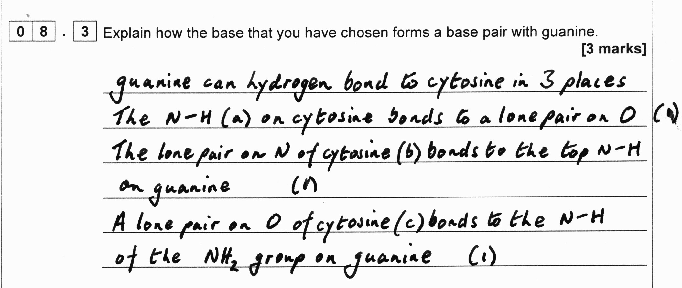
New topic exemplars – 2 (A2)
A-level Paper 2, question 8.3
Slide 38
Copyright © AQA and its licensors. All rights reserved.

Slide 39
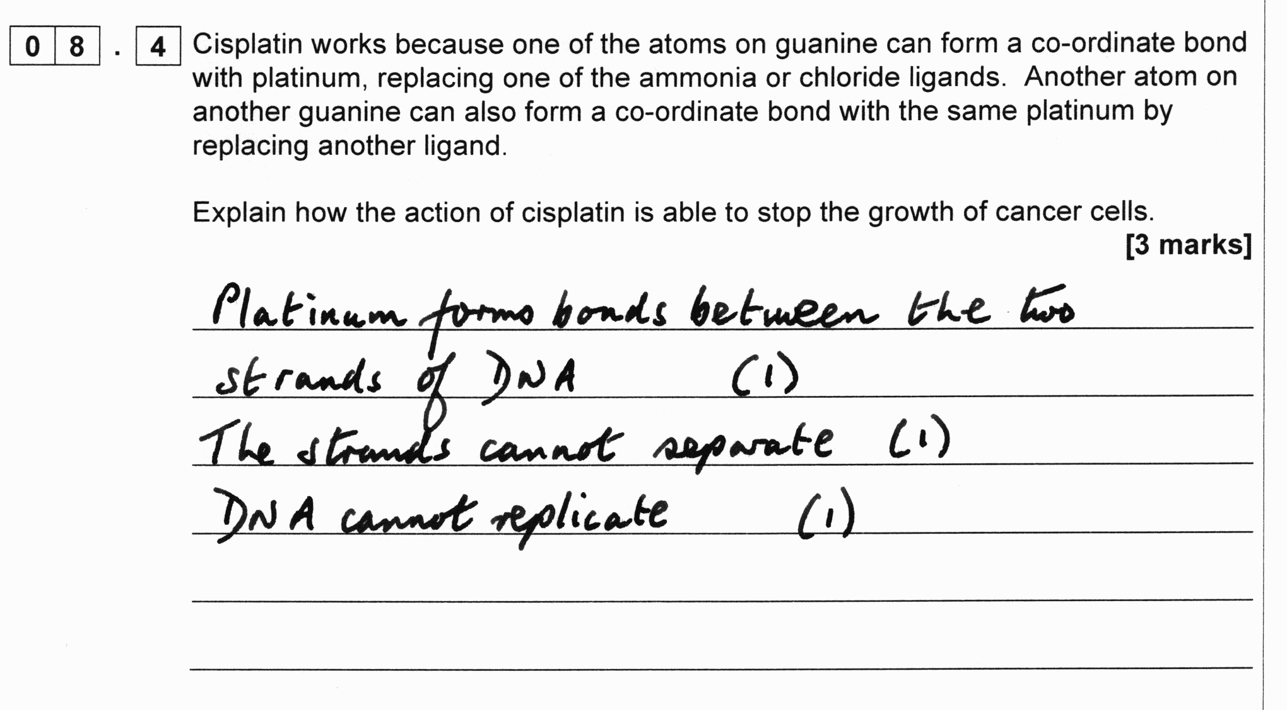
New topic exemplars – 2 (A2)
A-level Paper 2, question 8.4
Slide 39
Copyright © AQA and its licensors. All rights reserved.

Slide 40
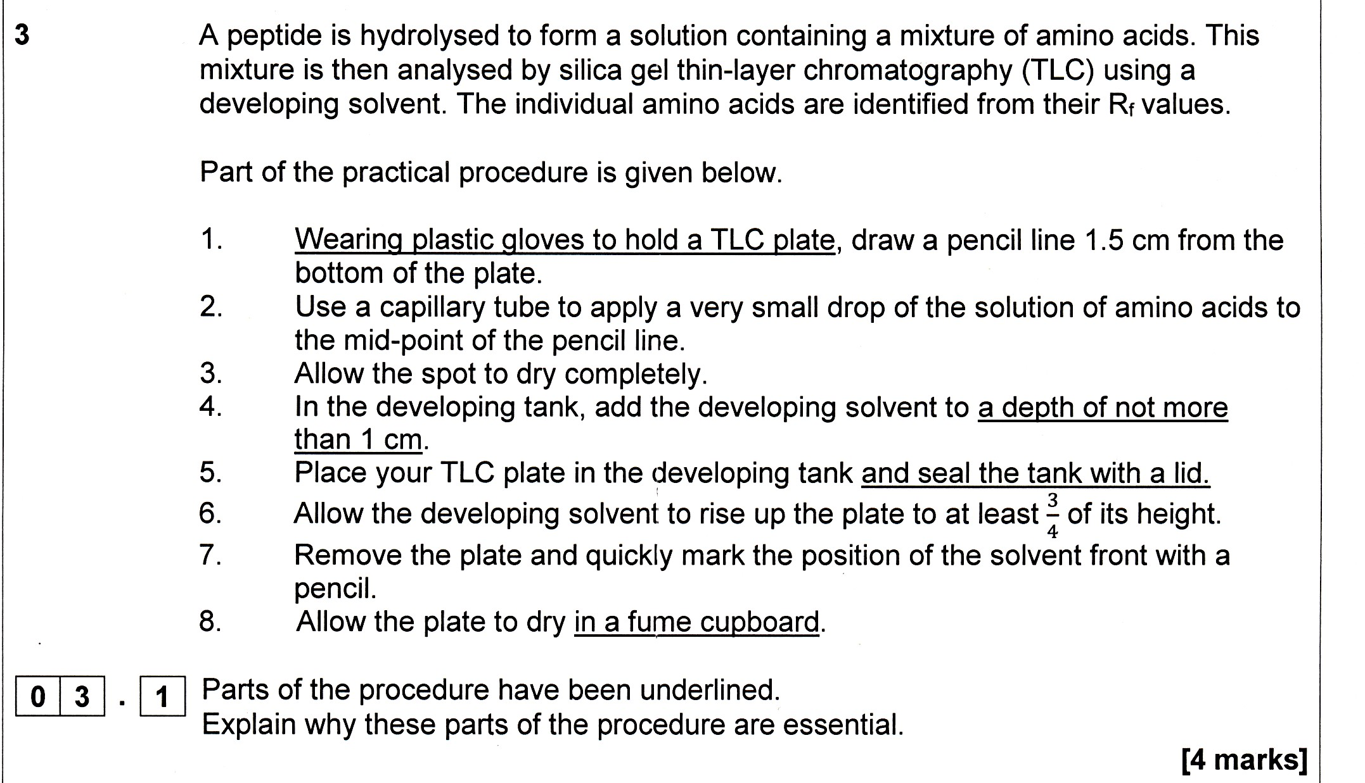
New topic exemplars – 3 (A3)
Chromatography: A-level Paper 3, question 3.1
Slide 40
Copyright © AQA and its licensors. All rights reserved.

Slide 41
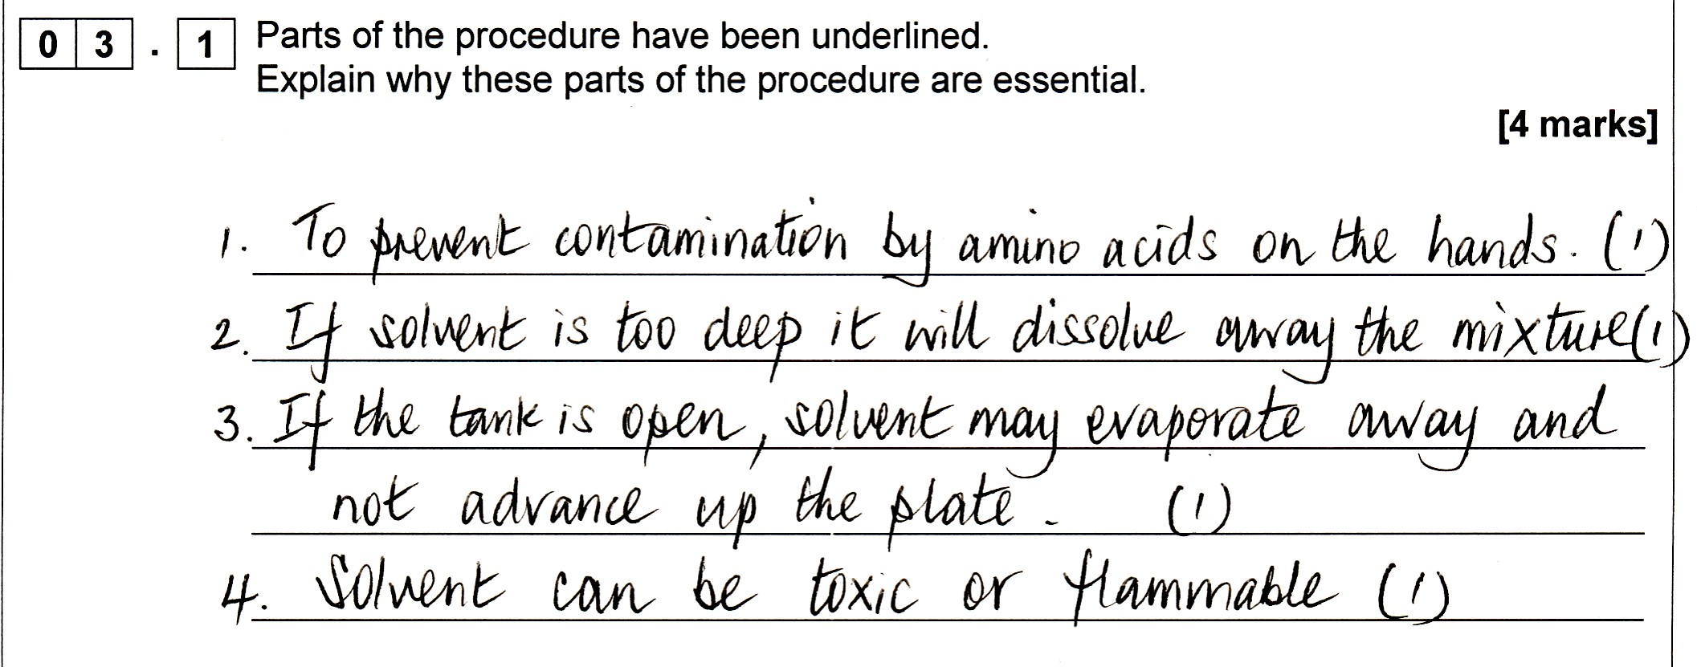
New topic exemplars – 3 (A3)
Chromatography: A-level Paper 3, question 3.1 continued
Slide 41
Copyright © AQA and its licensors. All rights reserved.

Slide 42
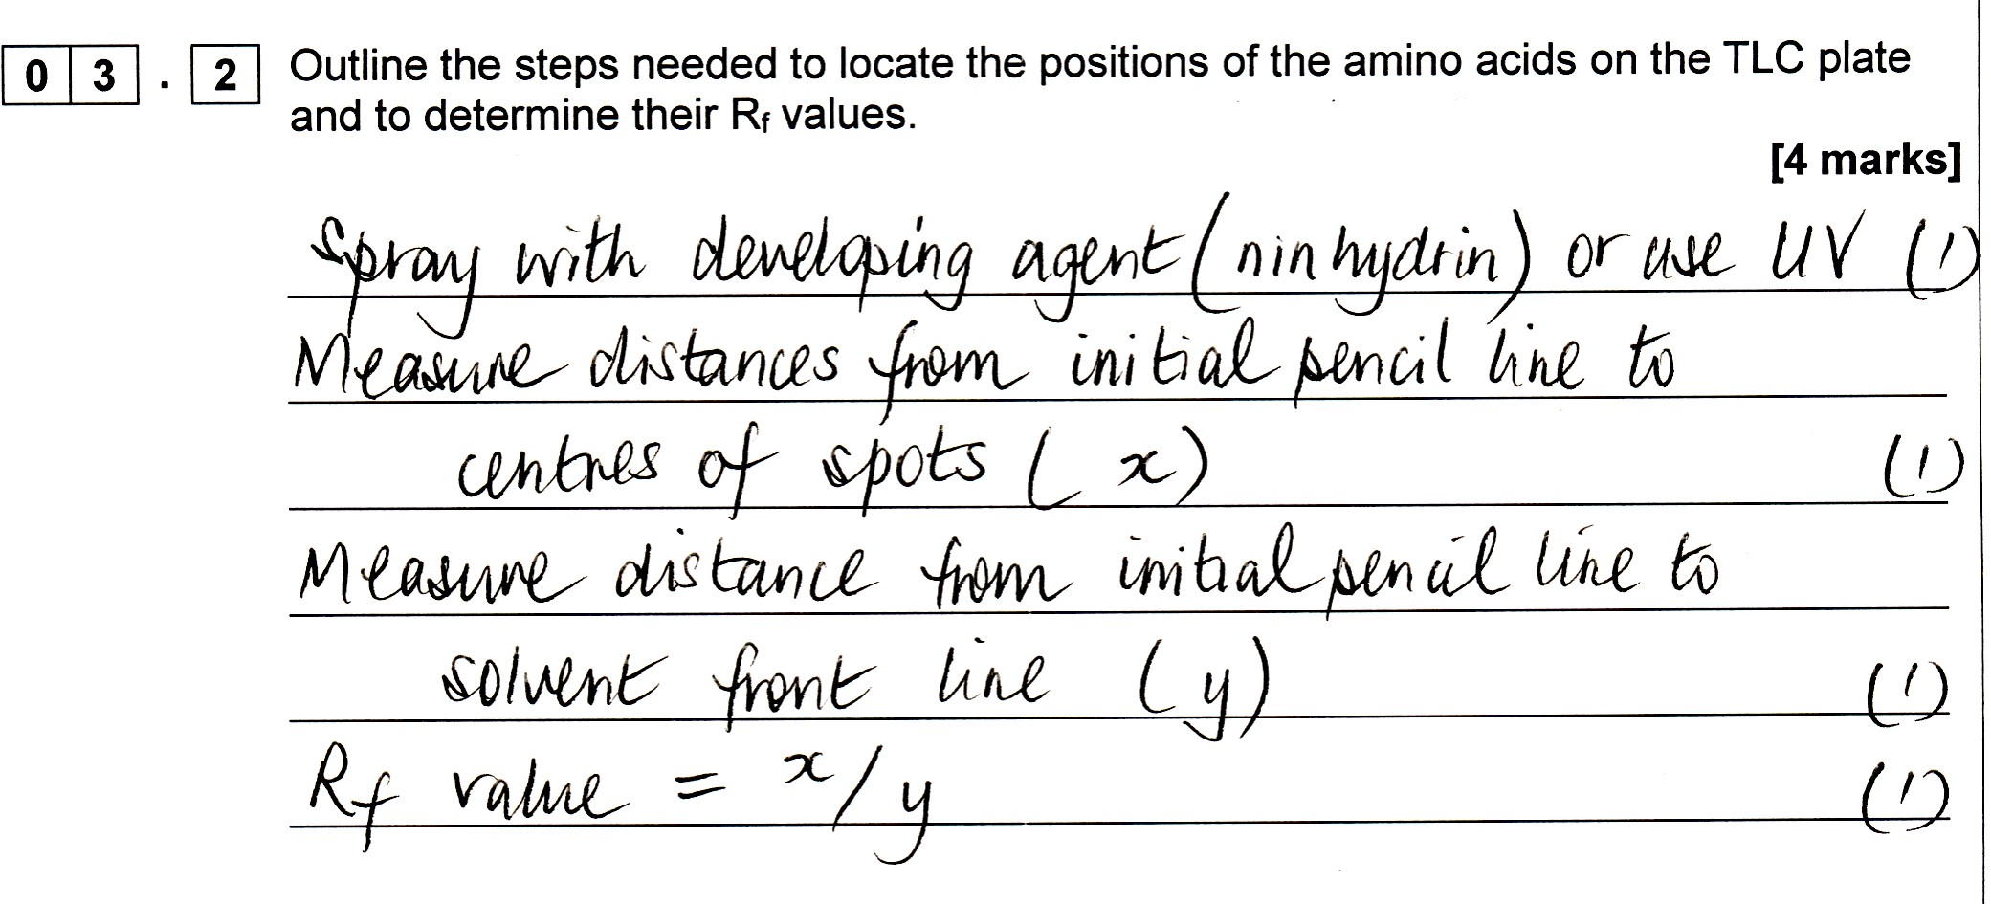
New topic exemplars – 3 (A3)
Chromatography: A-level Paper 3, question 3.2
Slide 42
Copyright © AQA and its licensors. All rights reserved.

Slide 43
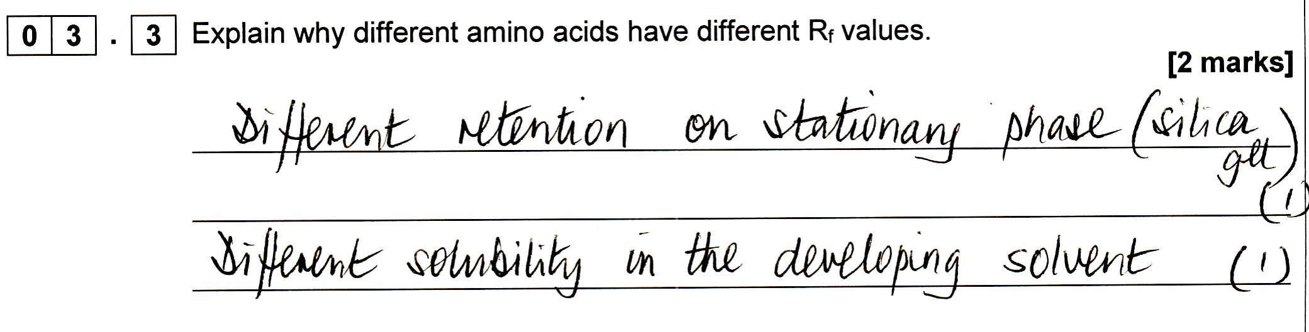
New topic exemplars – 3 (A3)
Chromatography: A-level Paper 3, question 3.3
Slide 43
Copyright © AQA and its licensors. All rights reserved.

Slide 44
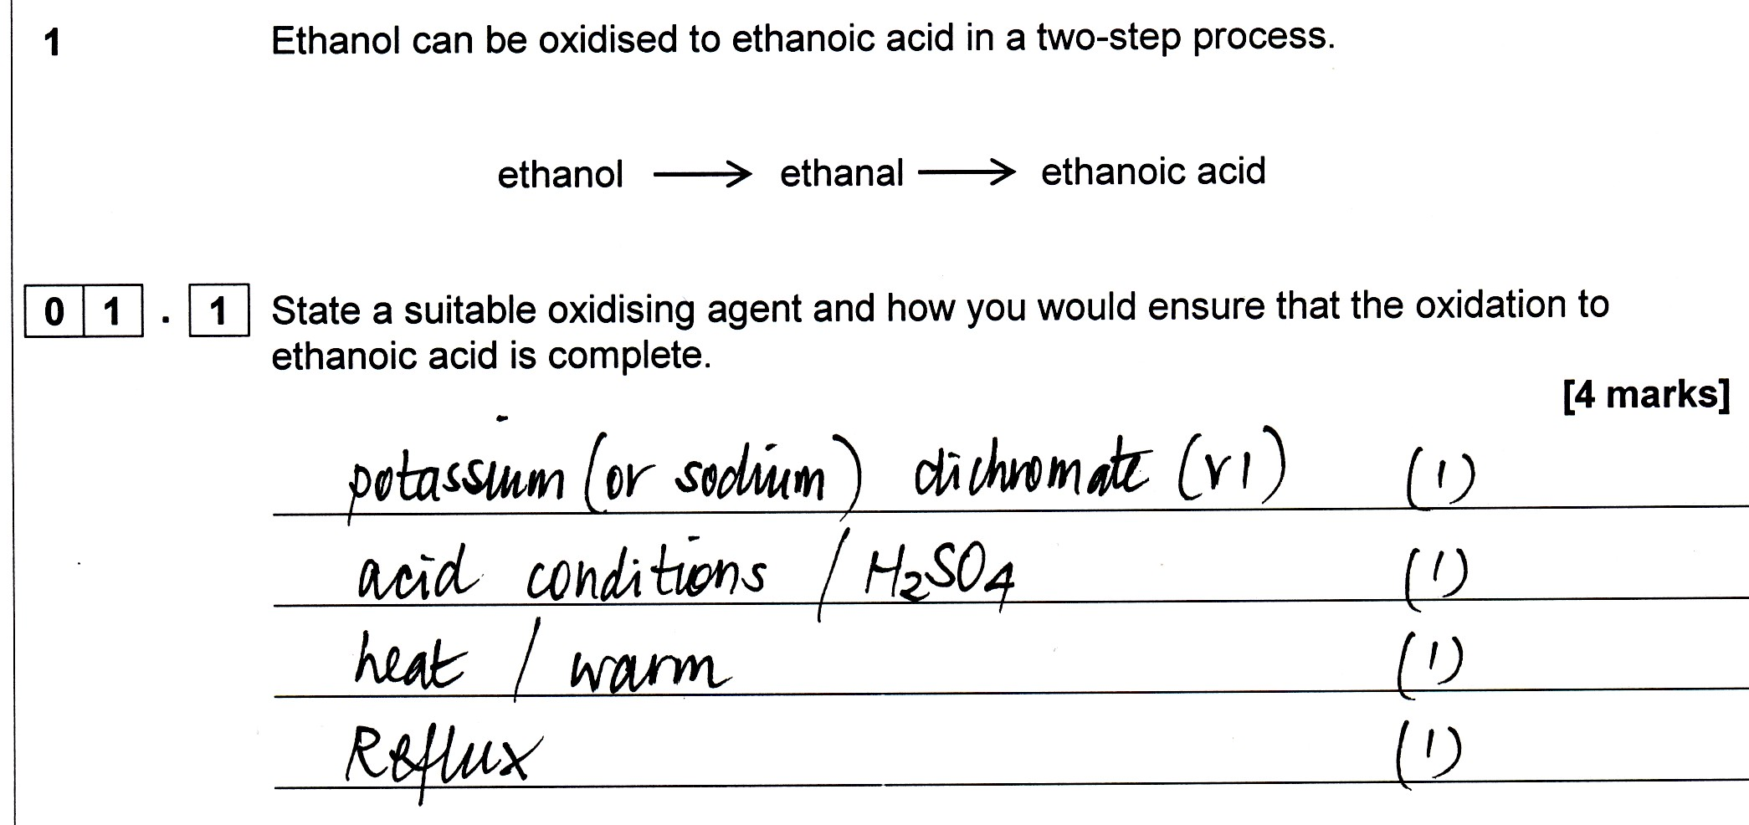
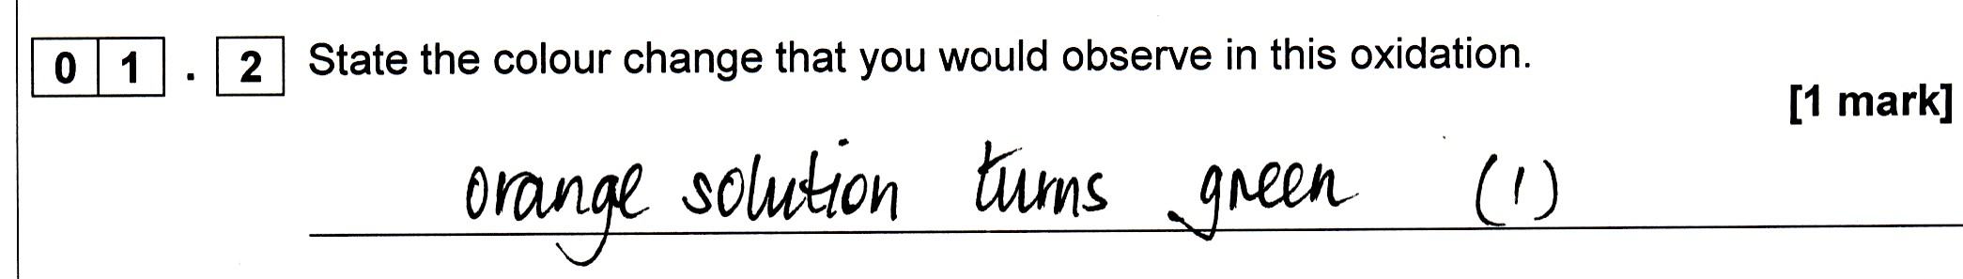
Practical skills exemplar -1 (A3)
A-level Paper 3, questions 1.1 and 1.2
Slide 44
Copyright © AQA and its licensors. All rights reserved.

Slide 45
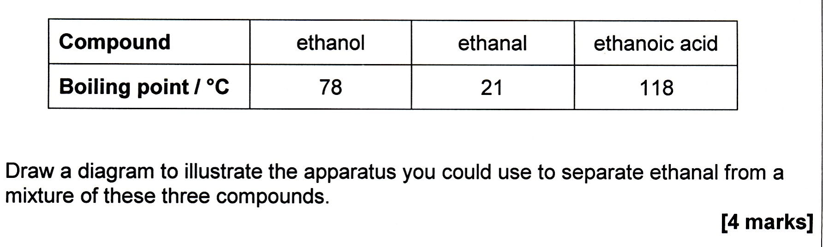
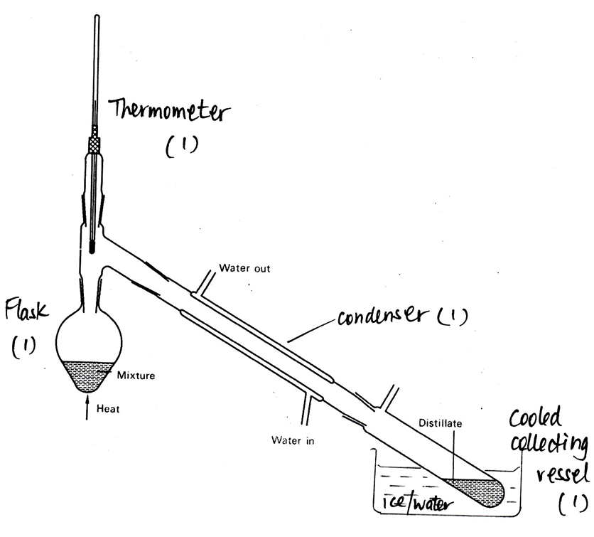
Practical skills exemplar -1 (A3)
A-level Paper 3, Q1.3
Slide 45
Copyright © AQA and its licensors. All rights reserved.

Slide 46
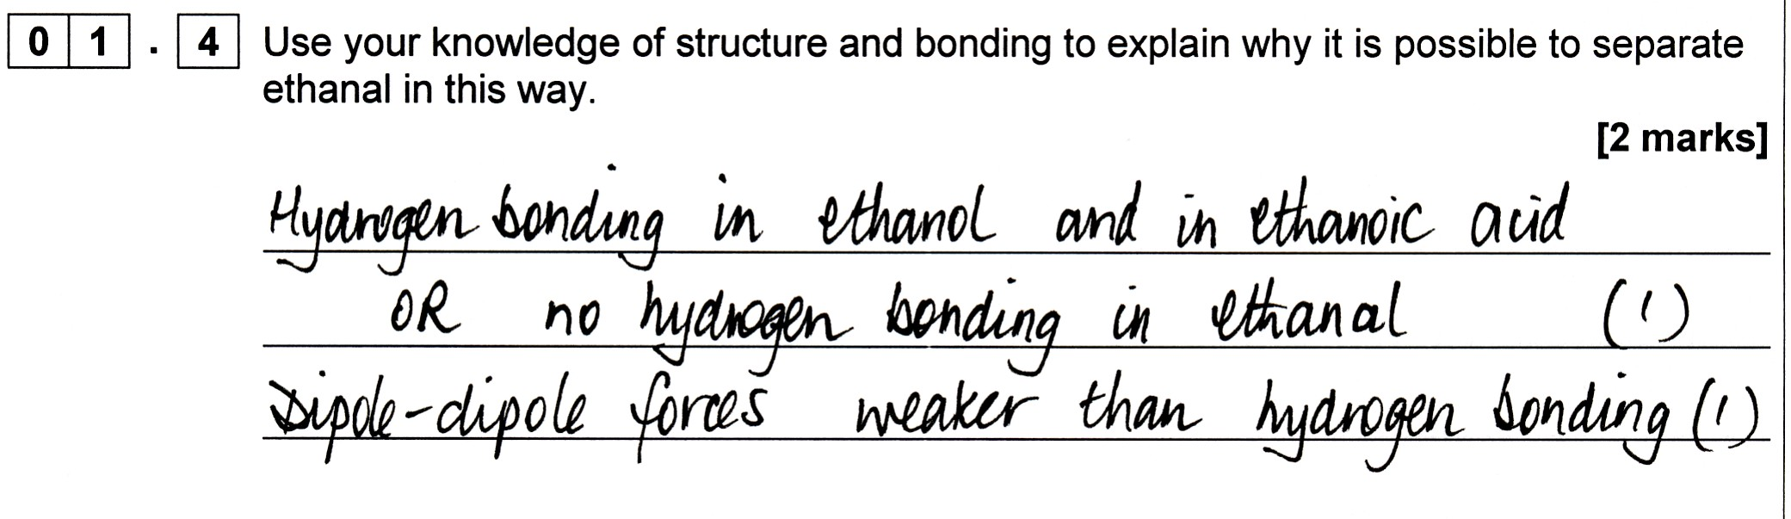
Practical skills exemplar -1 (A3)
A-level Paper 3, question 1.4
Slide 46
Copyright © AQA and its licensors. All rights reserved.

Slide 47
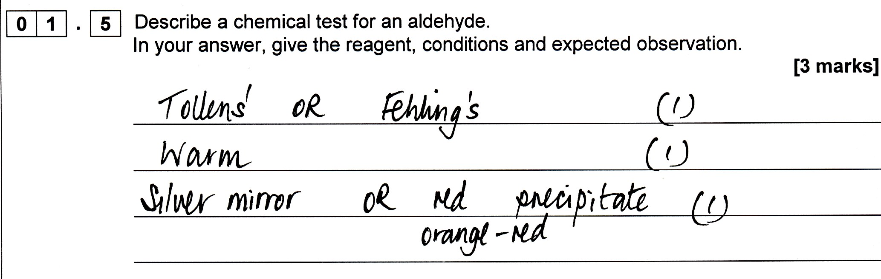
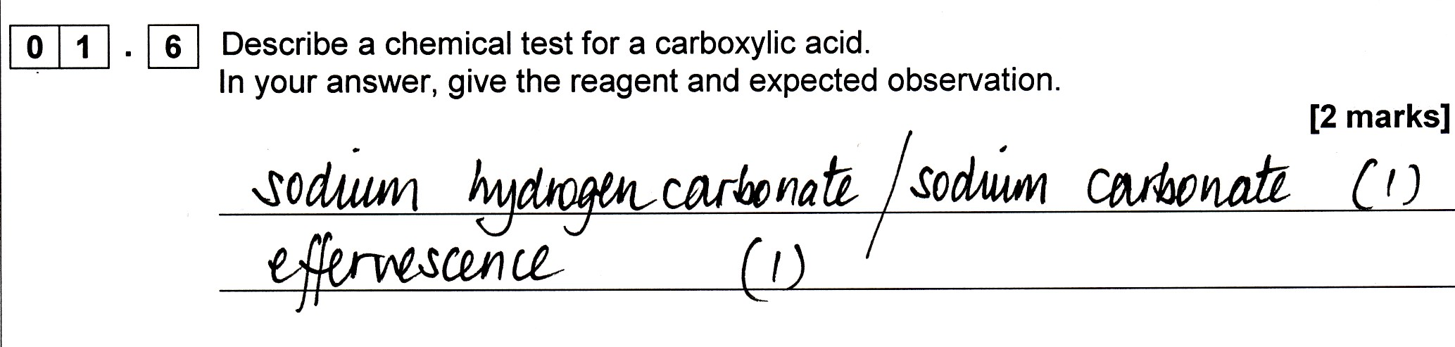
Practical skills exemplar -1 (A3)
A-level Paper 3, questions 1.5 and 1.6
Slide 47
Copyright © AQA and its licensors. All rights reserved.

Slide 48

Practical skills exemplar – 2 (A3)
A-level Paper 3, question 2.1
Slide 48
Copyright © AQA and its licensors. All rights reserved.

Slide 49
Practical skills exemplar – 2 (A3)
A-level Paper 3, question 2.1
02.1 | Moles of sodium hydroxide in each titration = (4.00 × 0.400) / 1000 = 1.6000 × 10^{–3} Hence, moles of acid in 250 cm³ of equilibrium mixture = 10 × 1.6000 × 10^{–3} = 1.6000 × 10^{–2} Moles of acid originally = 4.80 / 60.0 = 8.000 × 10^{–2} Moles of acid reacted = 8.000 × 10^{–2} – 1.600 × 10^{–2} = 6.4000 × 10^{–2} = moles ester and water formed Moles of ethanol remaining = 0.120 – 6.400 × 10^{–2} = 5.600 × 10^{–2} K_{a} = [CH₃COOCH₂CH₃] [H₂O] / [CH₃COOH] [CH₃CH₂OH] = (6.4 × 10^{–3})² / (1.6 × 10^{–3})(5.6 × 10^{–3}) = 4.57 (and precision to 3 significant figures) | 1 1 1 1 1 1 1
Slide 49
Copyright © AQA and its licensors. All rights reserved.

Slide 50
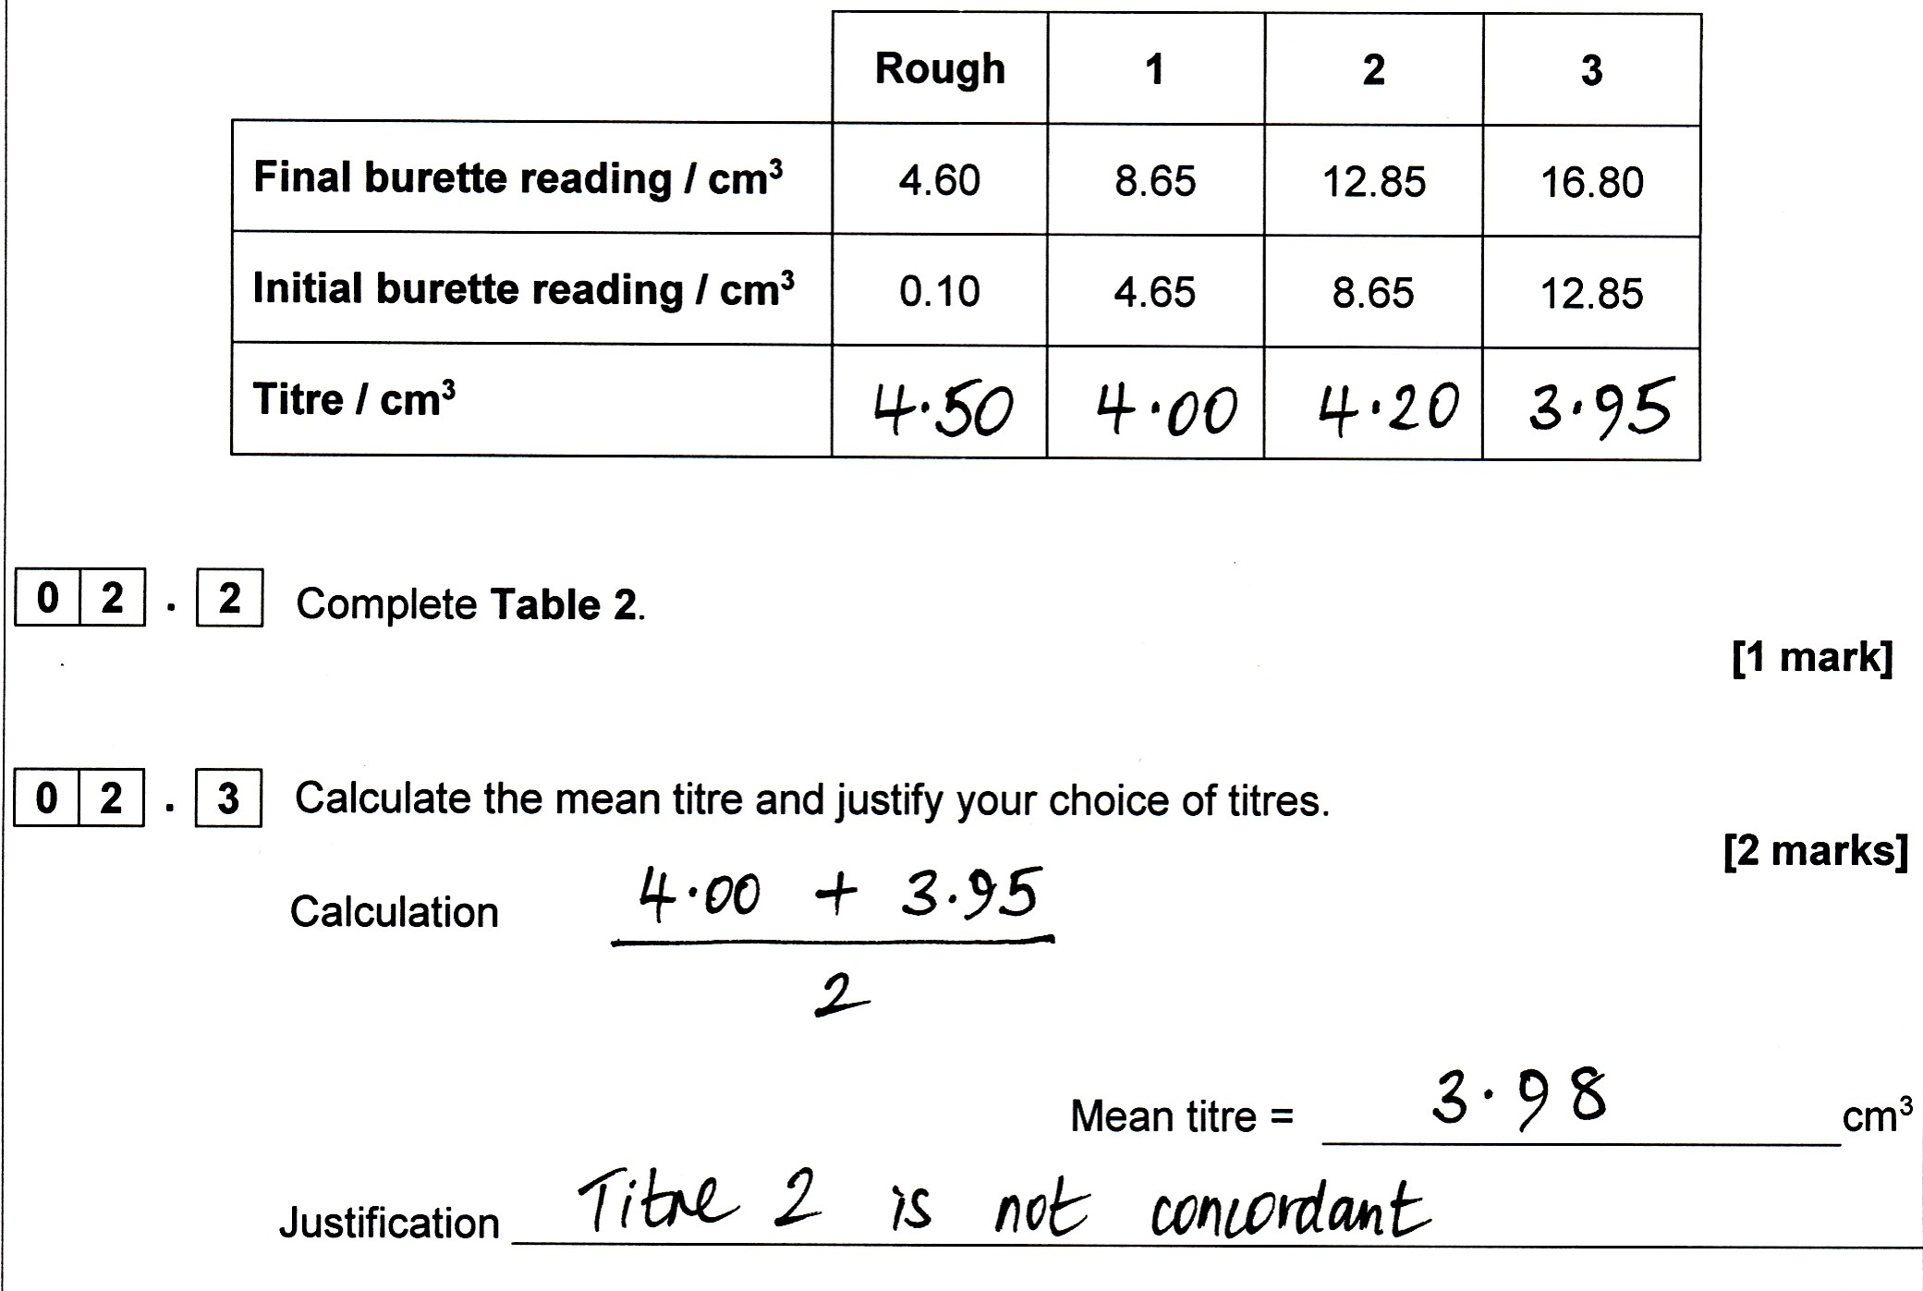
Practical skills exemplar – 2 (A3)
A-level Paper 3, questions 2.2 and 2.3
Slide 50
Copyright © AQA and its licensors. All rights reserved.

Slide 51
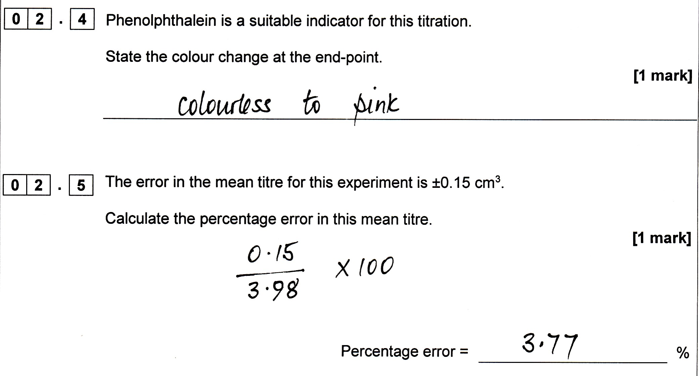
Practical skills exemplar – 2 (A3)
A-level Paper 3, questions 2.4 and 2.5
Slide 51
Copyright © AQA and its licensors. All rights reserved.

Slide 52
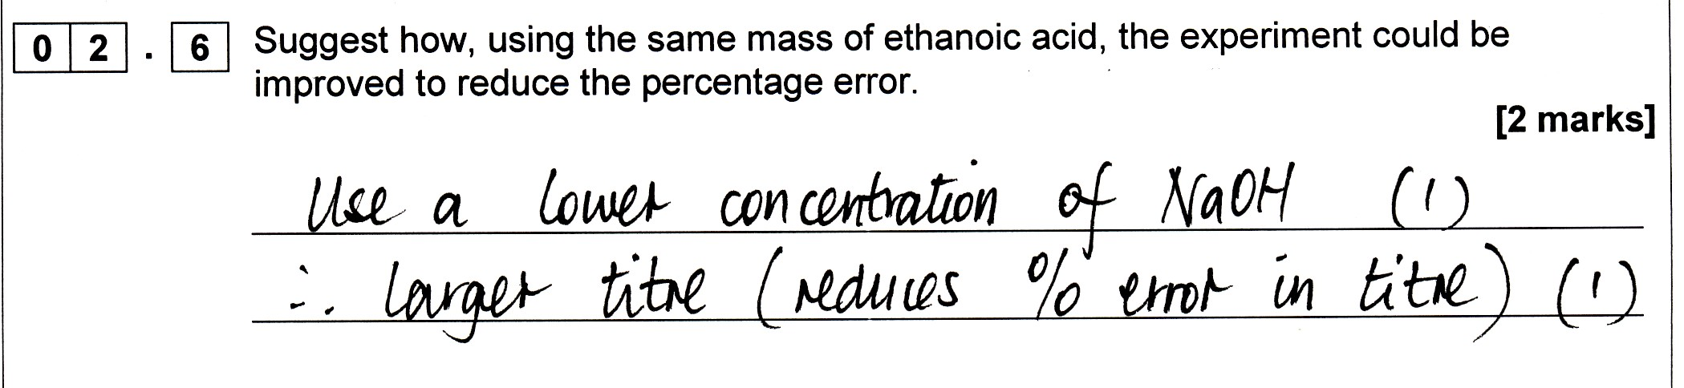
Practical skills exemplar – 2 (A3)
A-level Paper 3, question 2.6
Slide 52
Copyright © AQA and its licensors. All rights reserved.

Slide 53
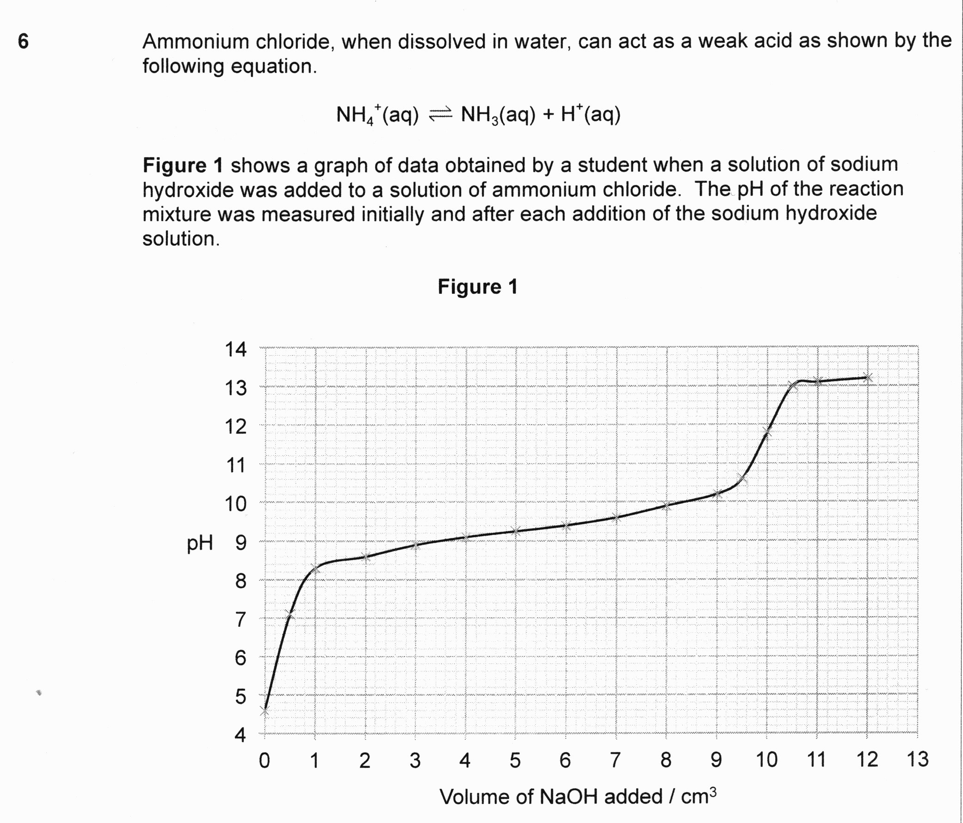
Practical skills exemplar – 3 (A1)
A-level Paper 1, question 6
Slide 53
Copyright © AQA and its licensors. All rights reserved.

Slide 54
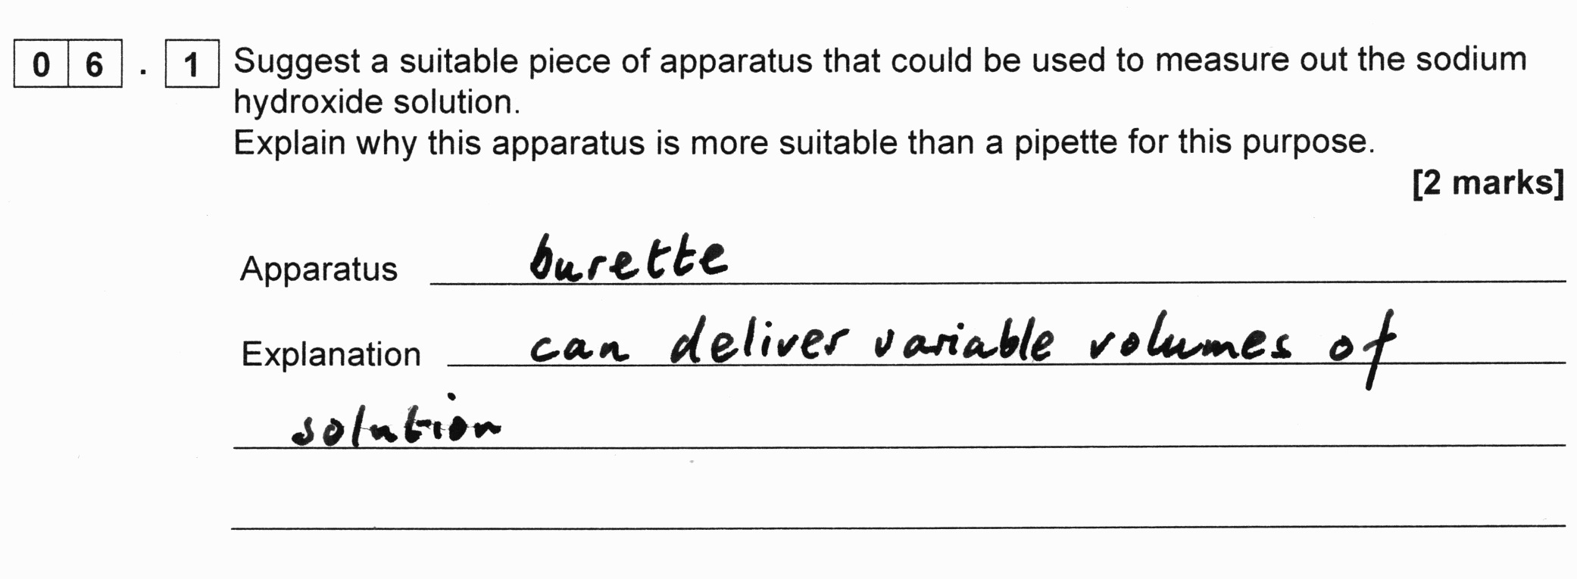
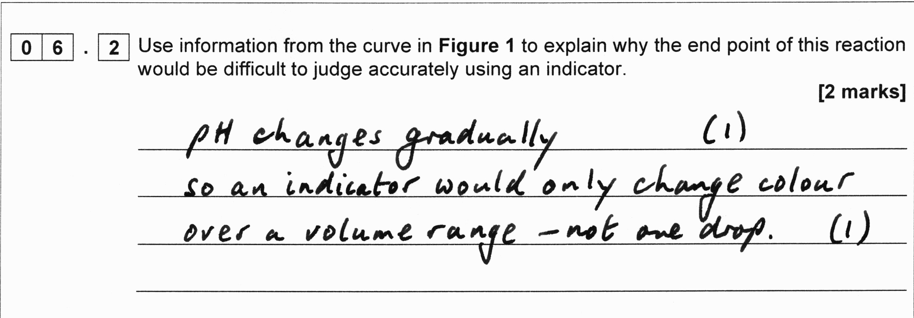
Practical skills exemplar – 3 (A1)
A-level Paper 1, questions 6.1 and 6.2
Slide 54
Copyright © AQA and its licensors. All rights reserved.

Slide 55
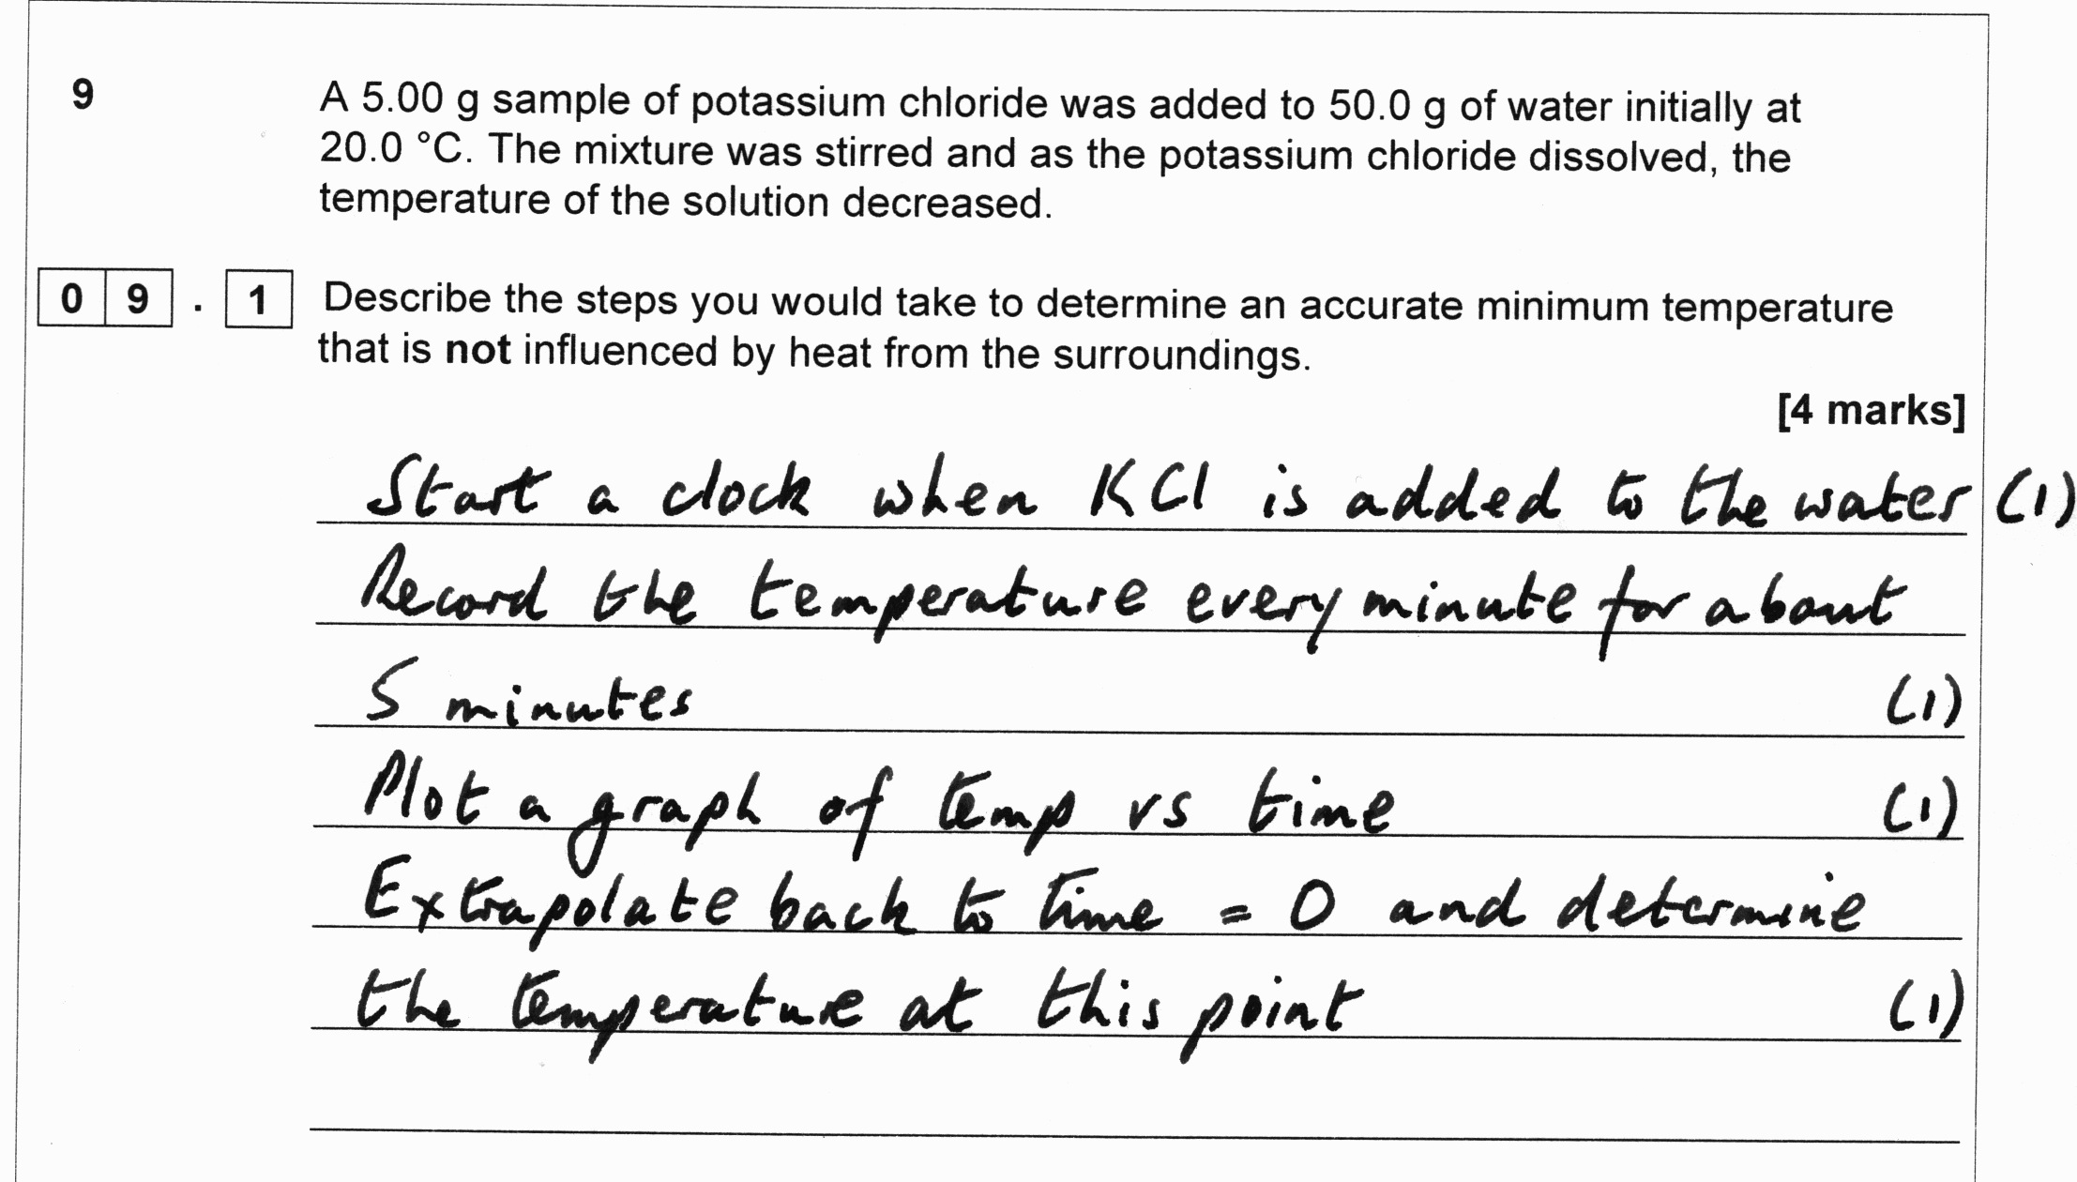
Practical skills exemplar – 3 (A1)
A-level Paper 1, question 9.1
Slide 55
Copyright © AQA and its licensors. All rights reserved.

Slide 56
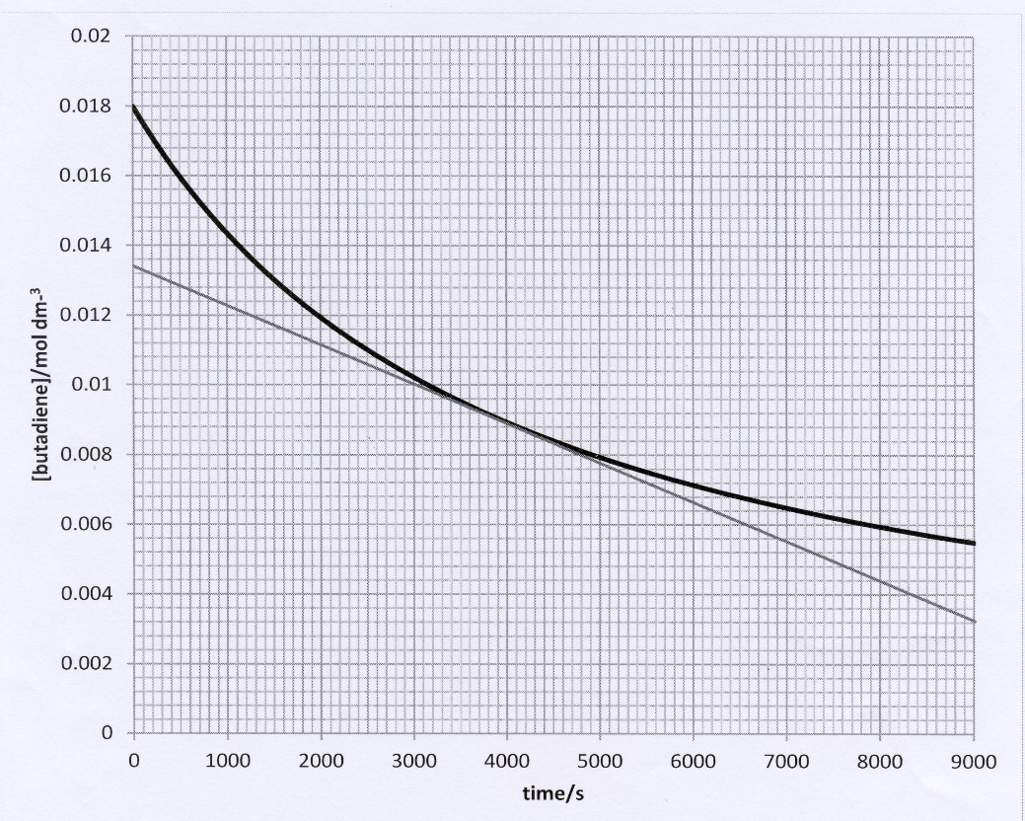
Practical skills exemplar – 4 (A2)
A-level Paper 2, question 2
Butadiene dimerises according to the equation 2C₄H₆ → C₈H₁₂
The kinetics of the dimerisation are studied and a graph of the concentration of a sample of butadiene is plotted against time.
Draw a tangent to the curve when the concentration of butadiene is 0.0090 mol dm^{–3}.
Slide 56
Copyright © AQA and its licensors. All rights reserved.

Slide 57
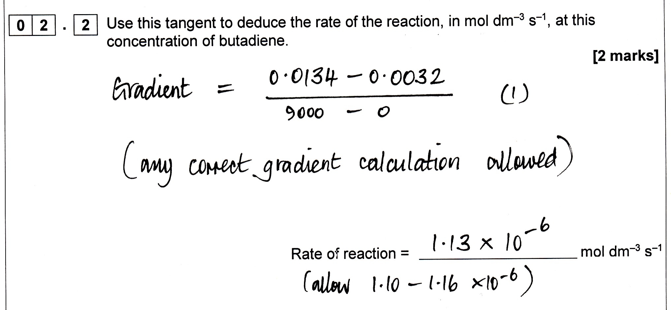
Practical skills exemplar – 4 (A2)
A-level Paper 2, question 2.2
Slide 57
Copyright © AQA and its licensors. All rights reserved.

Slide 58
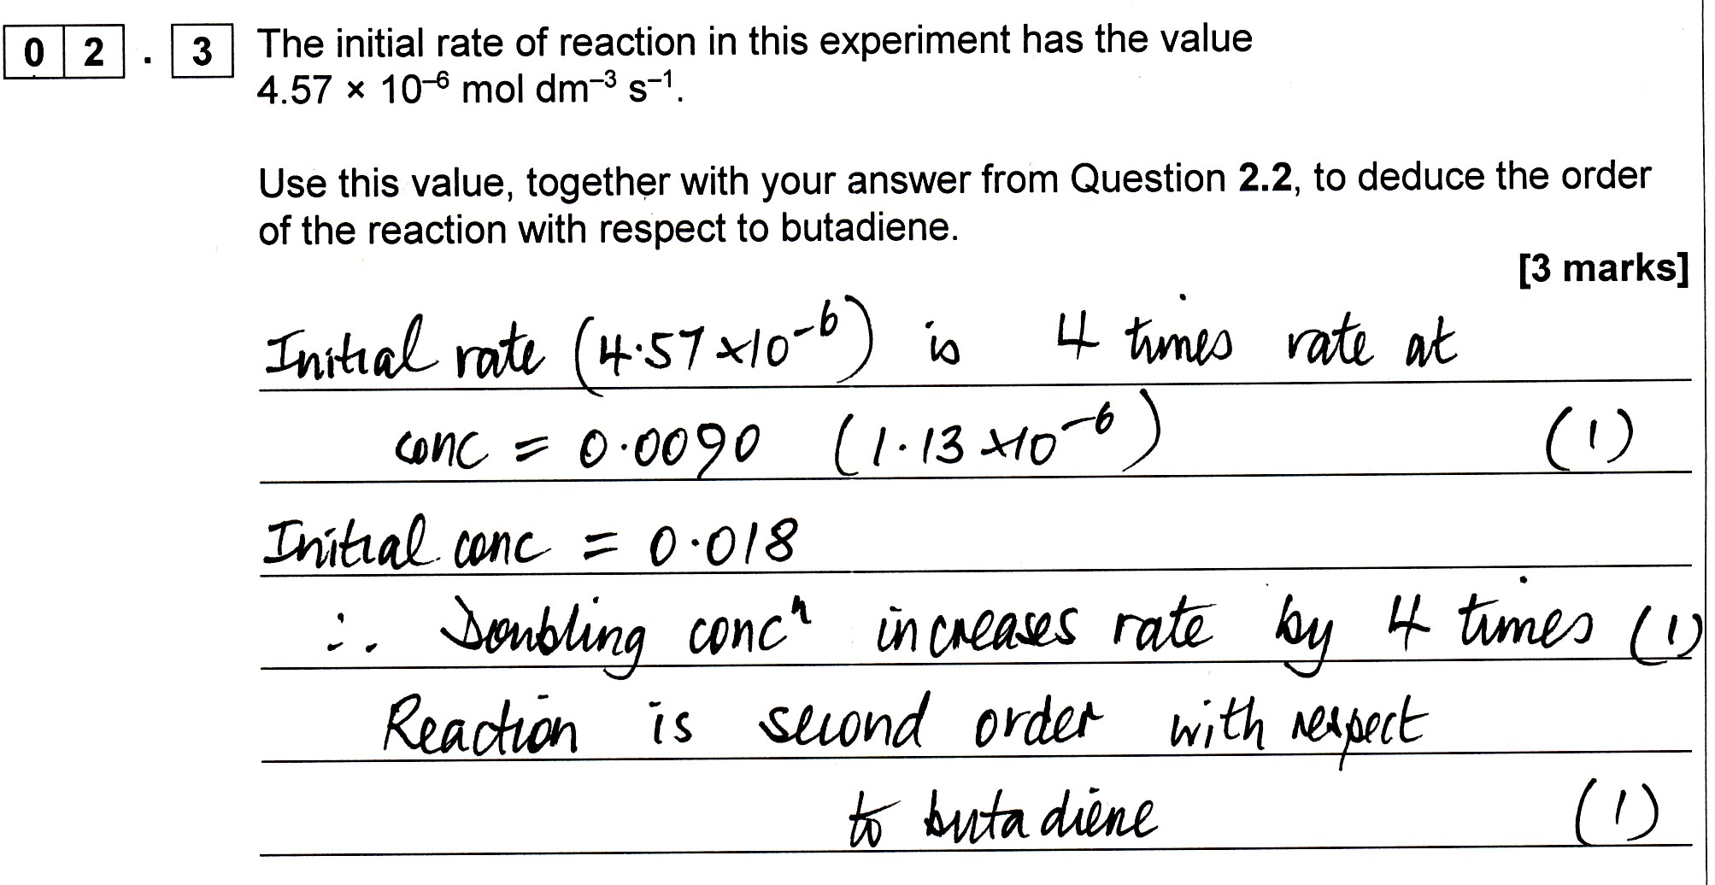
Practical skills exemplar – 4 (A2)
A-level Paper 2, question 2.3
Slide 58
Copyright © AQA and its licensors. All rights reserved.

Slide 59
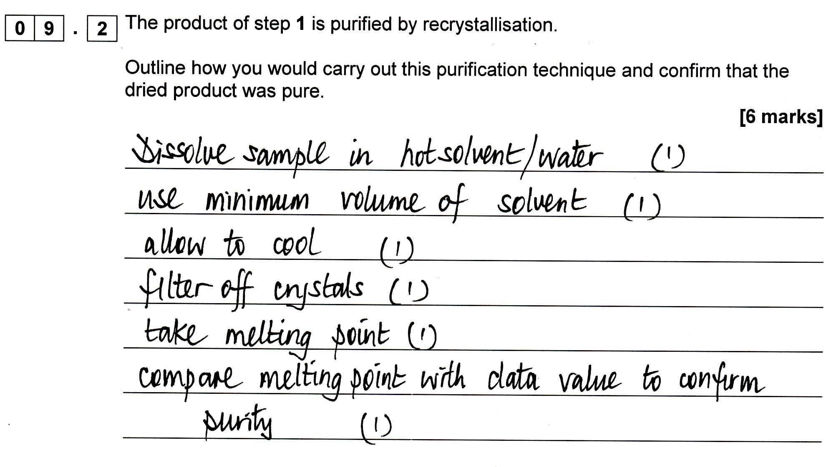
Practical skills exemplar – 4 (A2)
N-phenylethanamide
A-level Paper 2, question 9.2
Slide 59
Copyright © AQA and its licensors. All rights reserved.

Slide 60
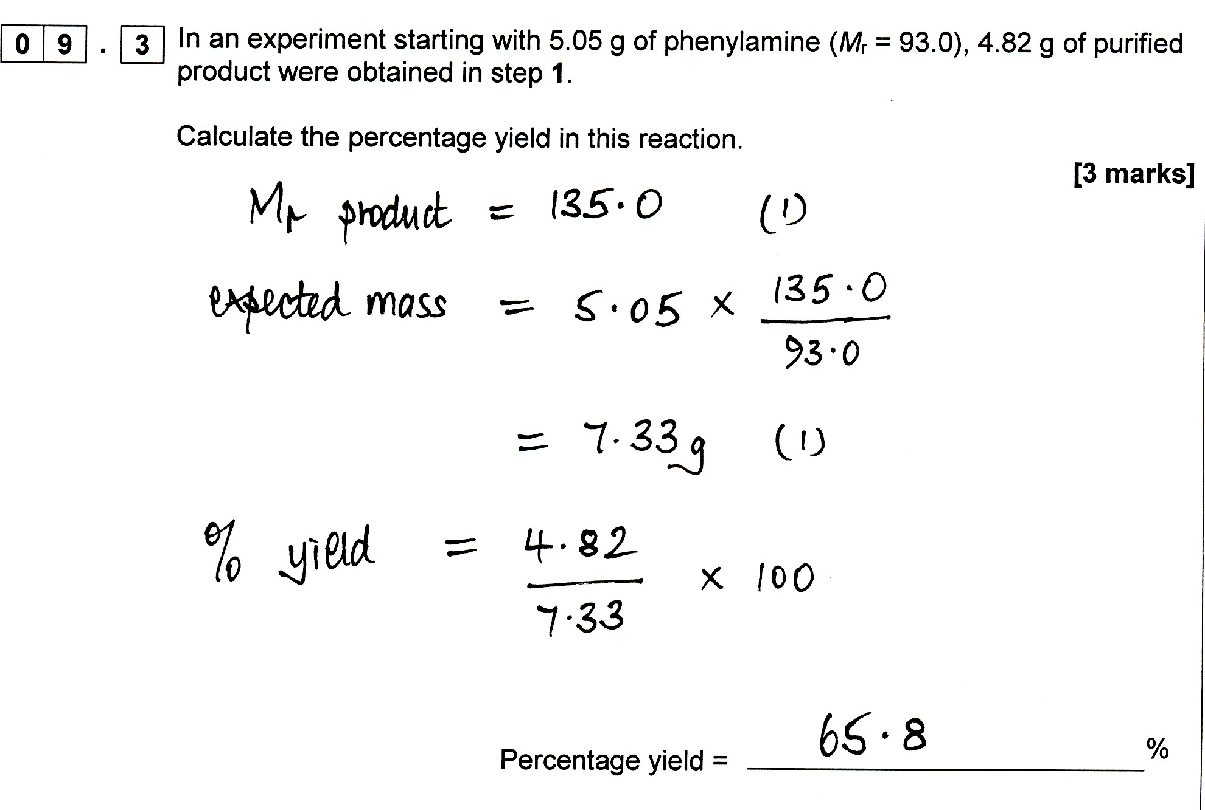
Practical skills exemplar – 4 (A2)
A-level Paper 2, question 9.3
Slide 60
Copyright © AQA and its licensors. All rights reserved.

Slide 61
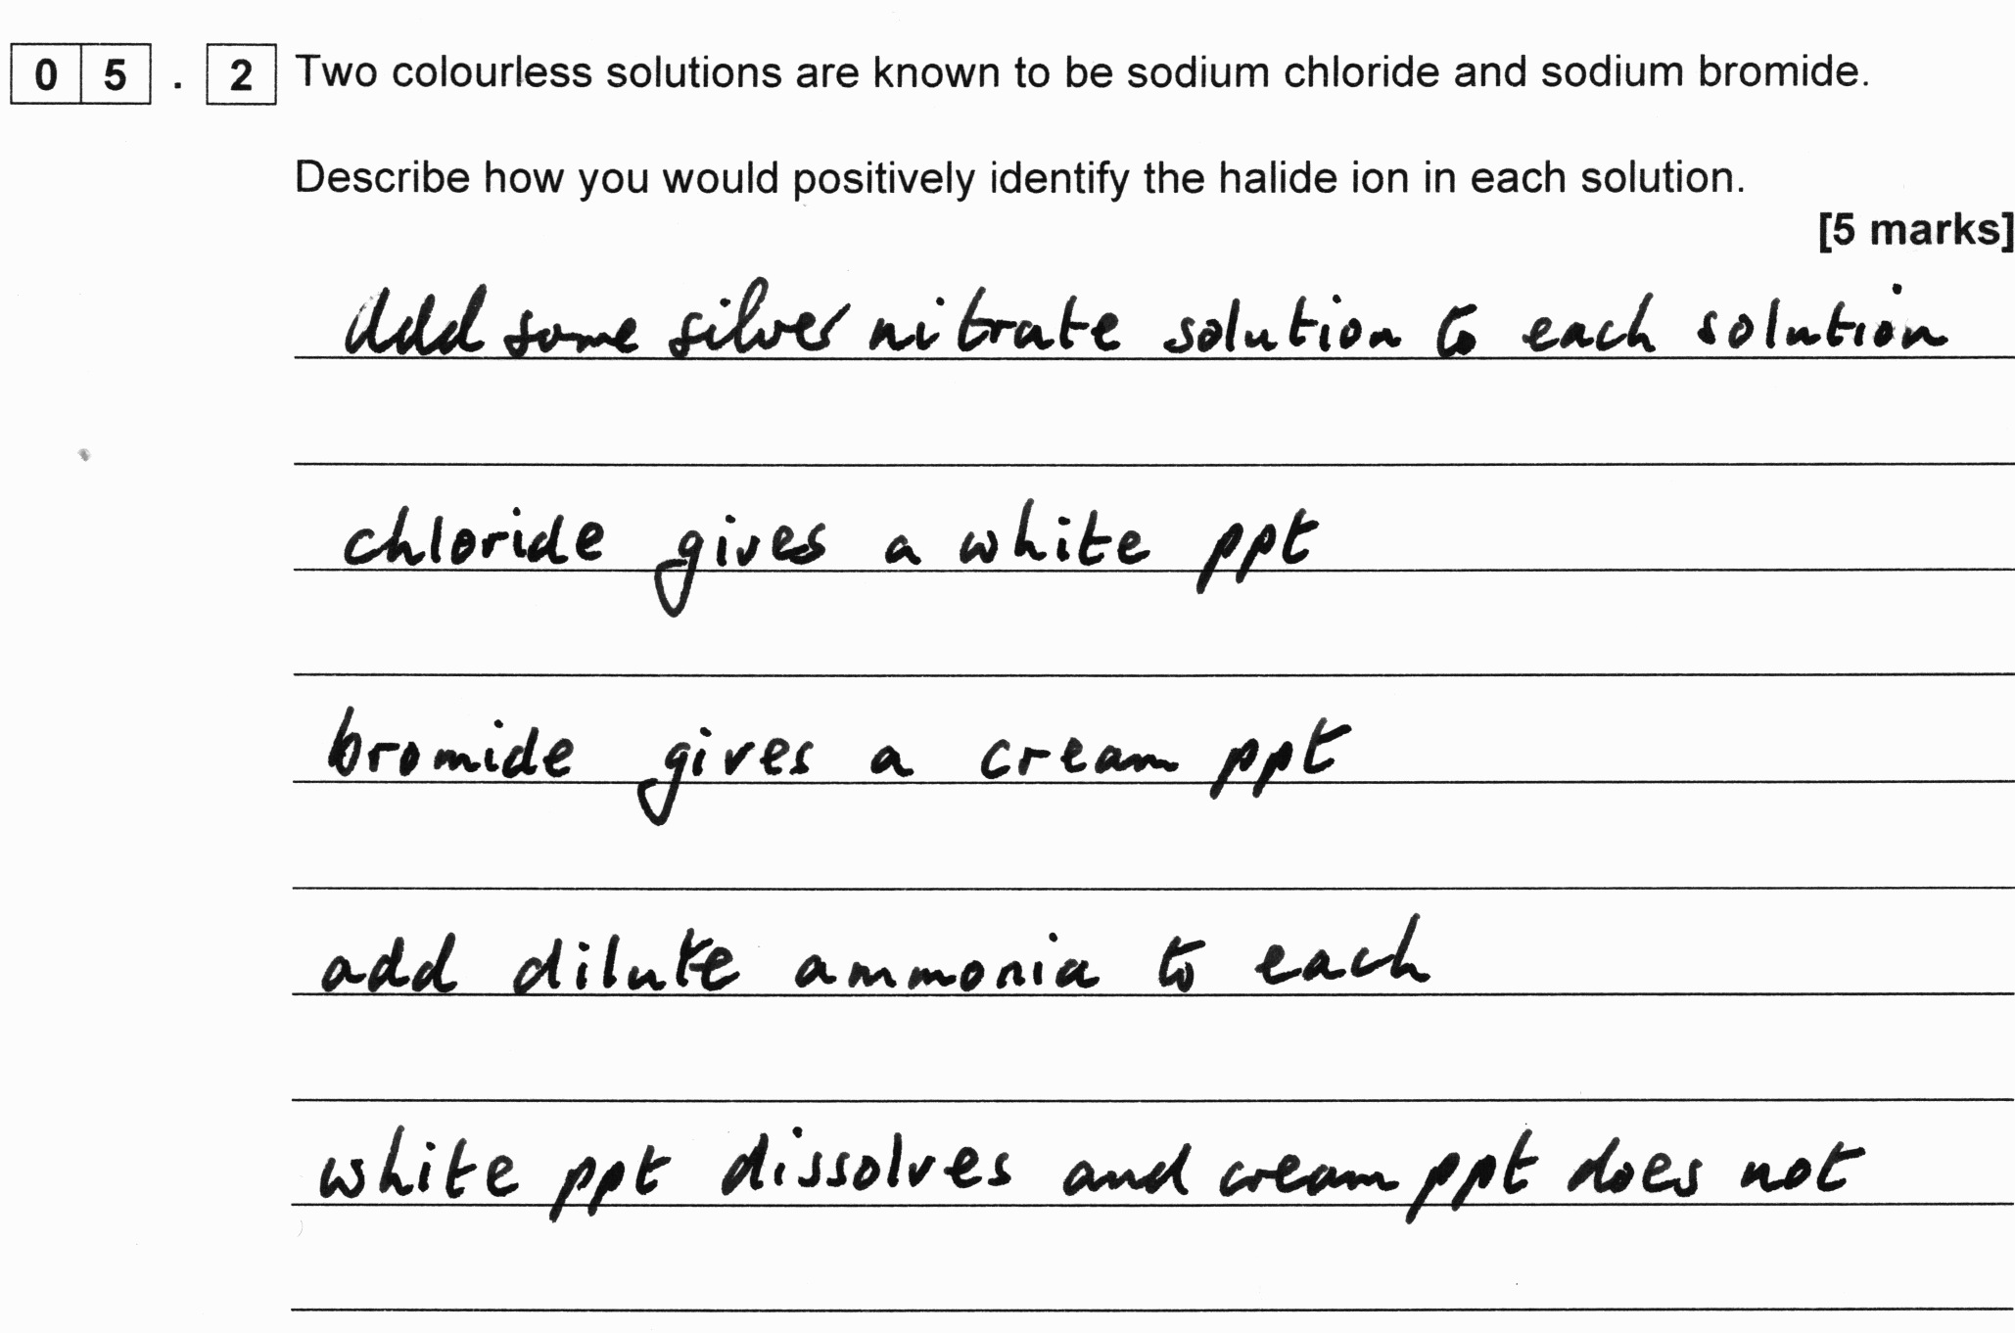
Practical skills exemplar – 5 (AS1)
AS Paper 1, question 5.2
Slide 61
Copyright © AQA and its licensors. All rights reserved.

Slide 62
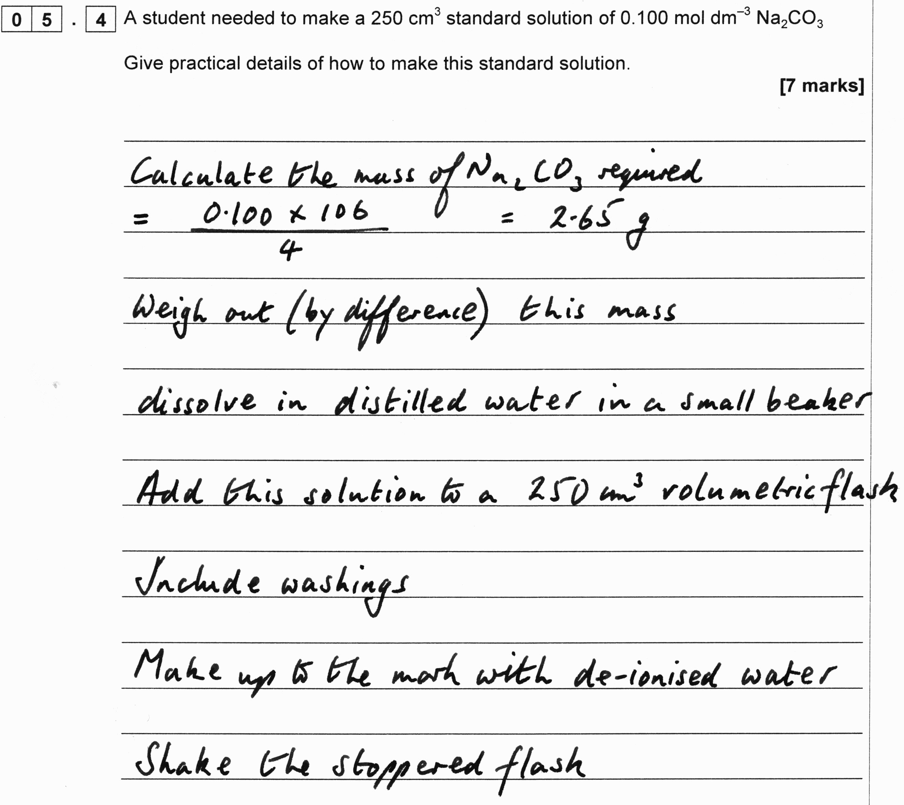
Practical skills exemplar – 5 (AS1)
AS Paper 1, question 5.4
Slide 62
Copyright © AQA and its licensors. All rights reserved.

Slide 63
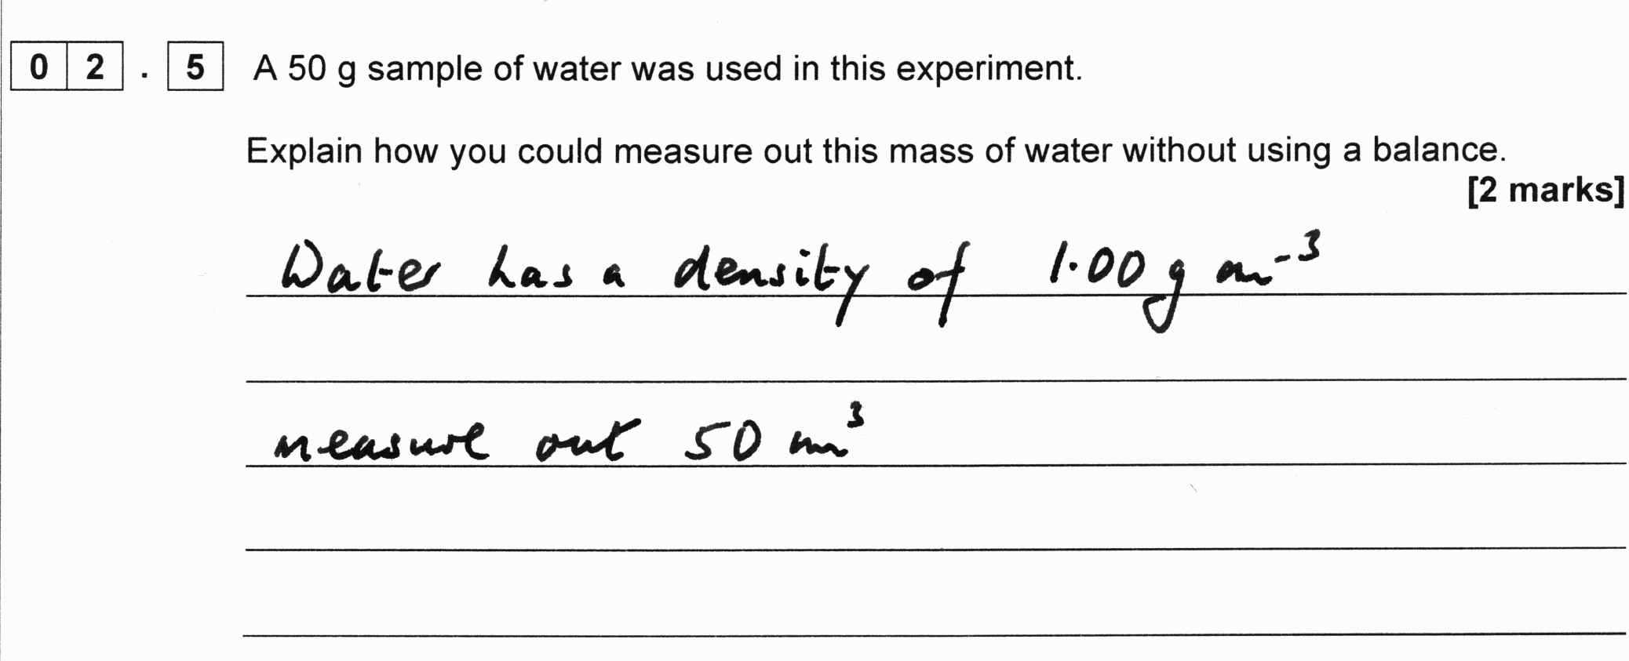
Practical skills exemplar – 6 (AS2)
AS Paper 2, question 2.5
Slide 63
Copyright © AQA and its licensors. All rights reserved.

Slide 64
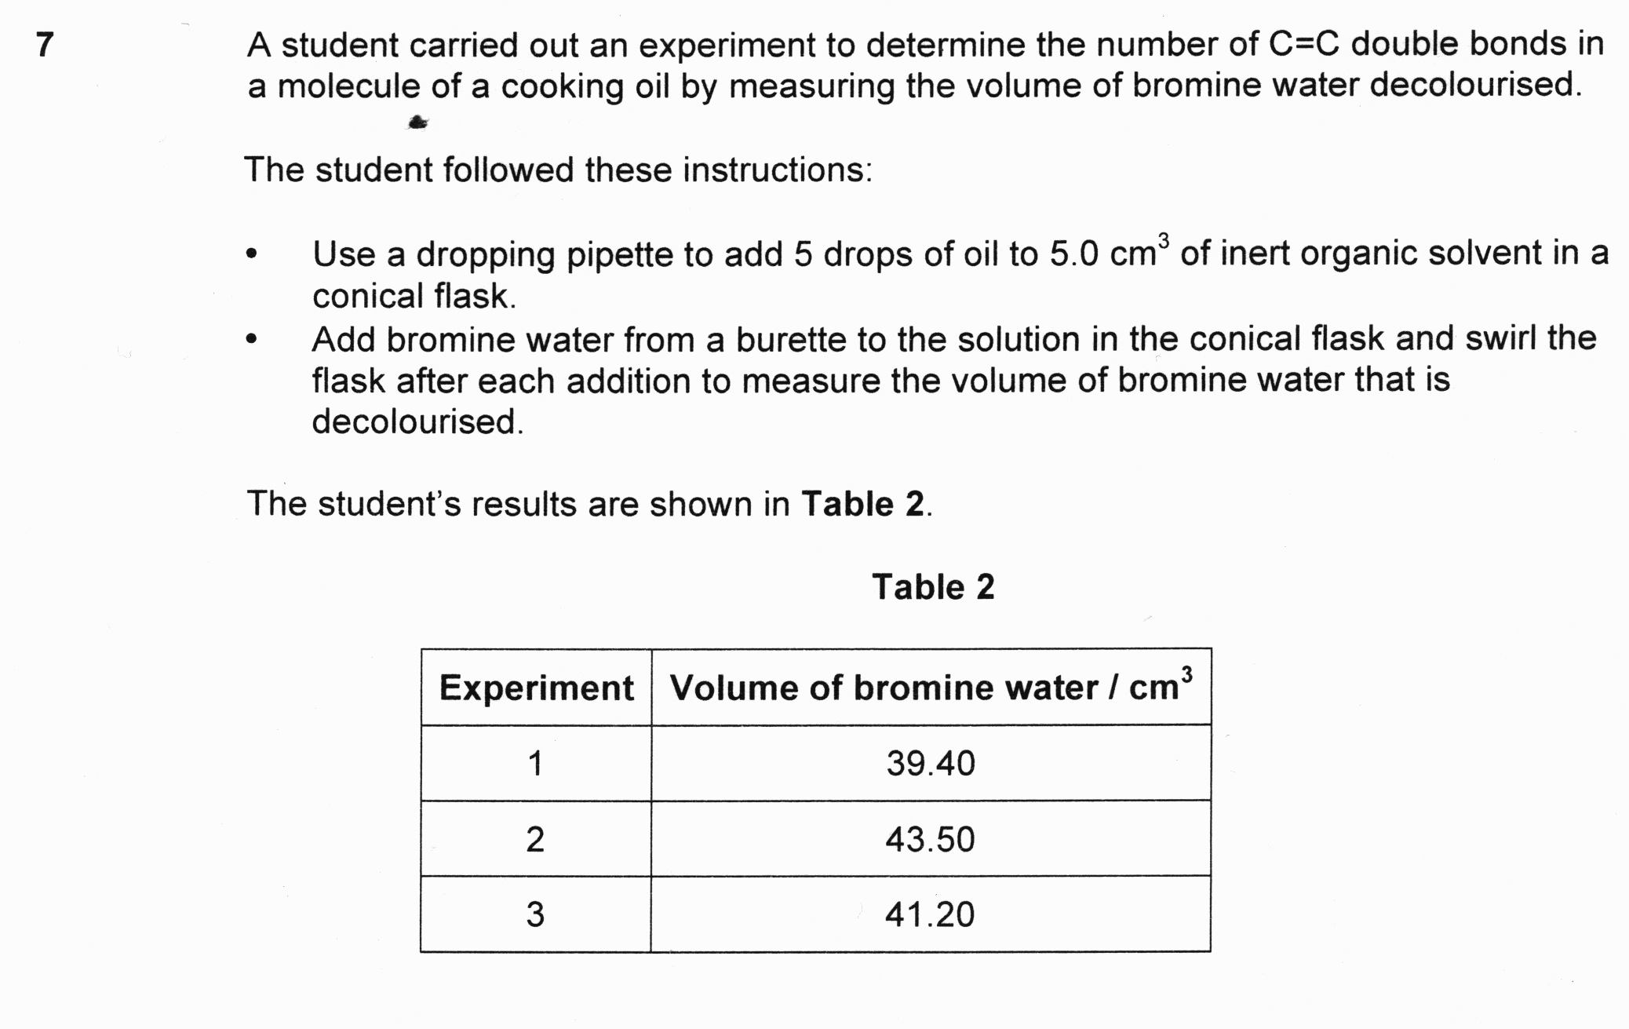
Practical skills exemplar – 6 (AS2)
AS Paper 2, question 7
Slide 64
Copyright © AQA and its licensors. All rights reserved.

Slide 65
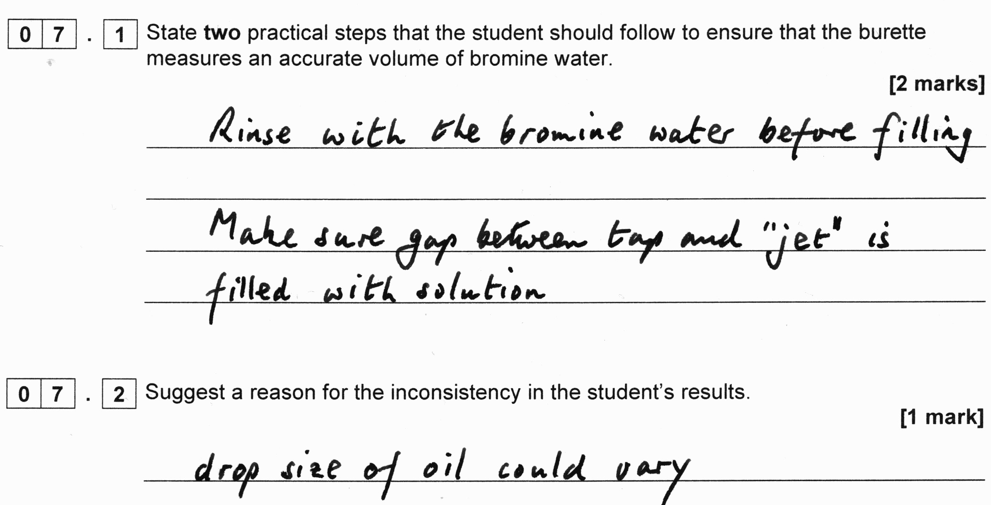
Practical skills exemplar – 6 (AS2)
AS Paper 2, questions 7.1 and 7.2
Slide 65
Copyright © AQA and its licensors. All rights reserved.

Slide 66
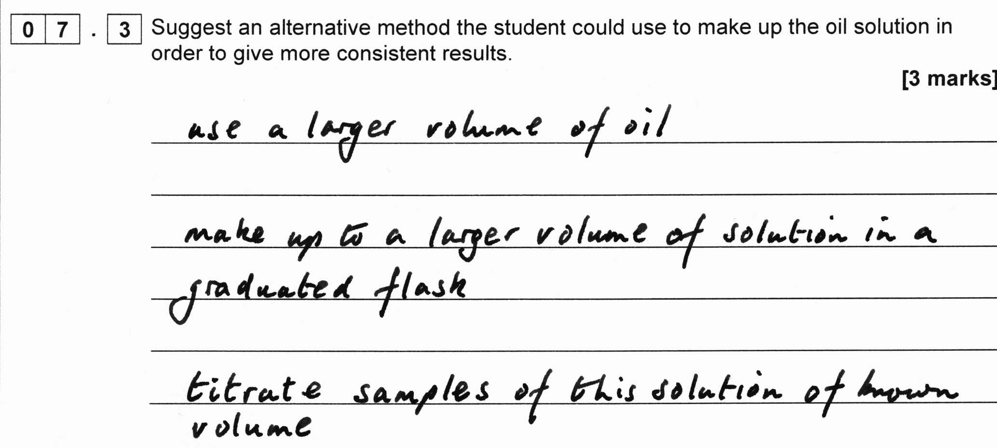
Practical skills exemplar – 6 (AS2)
AS Paper 2, question 7.3
Slide 66
Copyright © AQA and its licensors. All rights reserved.

Slide 67
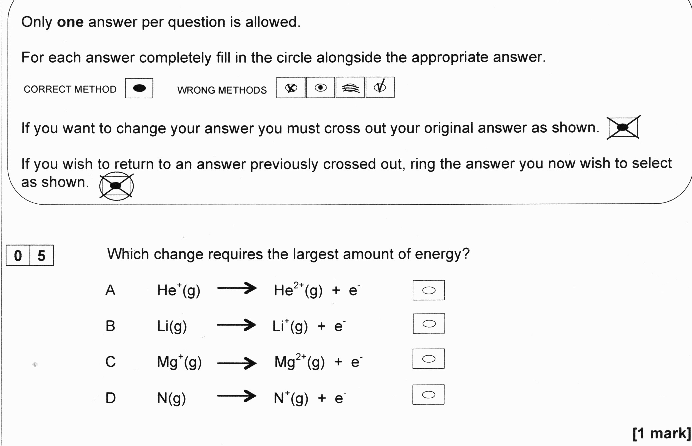
Multiple choice exemplar – 1 (A3 Section B)
Slide 67
Copyright © AQA and its licensors. All rights reserved.

Slide 68
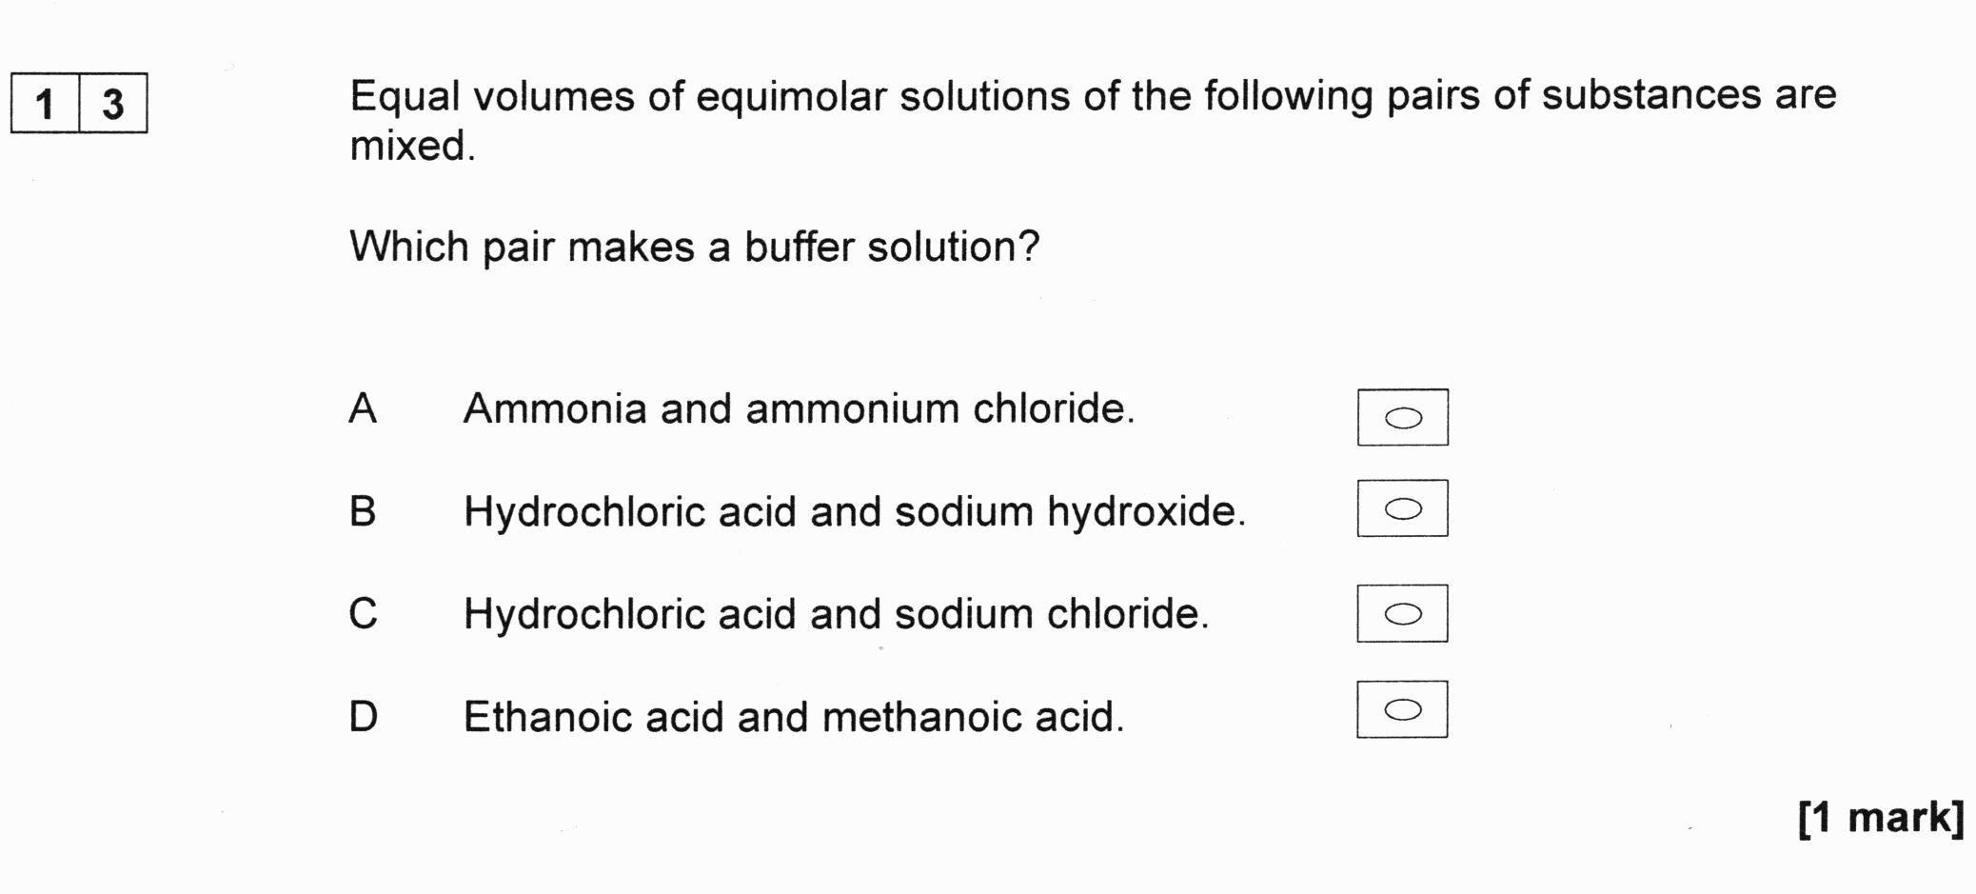
Multiple choice exemplar – 1 (A3 Section B)
Slide 68
Copyright © AQA and its licensors. All rights reserved.

Slide 69

Multiple choice exemplar – 1 (A3 Section B)
Slide 69
Copyright © AQA and its licensors. All rights reserved.

Slide 70

Multiple choice exemplar – 1 (A3 Section B)
Slide 70
Copyright © AQA and its licensors. All rights reserved.

Slide 71

Multiple choice exemplar – 1 (A3 Section B)
Slide 71
Copyright © AQA and its licensors. All rights reserved.

Slide 72

Multiple choice exemplar – 2 (AS1 Section B)
Slide 72
Copyright © AQA and its licensors. All rights reserved.

Slide 73

Multiple choice exemplar – 2 (AS1 Section B)
Slide 73
Copyright © AQA and its licensors. All rights reserved.

Slide 74

Multiple choice exemplar – 2 (AS1 Section B)
Slide 74
Copyright © AQA and its licensors. All rights reserved.

Slide 75

Multiple choice exemplar – 2 (AS2 Section B)
Slide 75
Copyright © AQA and its licensors. All rights reserved.

Slide 76

Multiple choice exemplar – 2 (AS2 Section B)
Questions 21 and 22 (stem)
Slide 76
Copyright © AQA and its licensors. All rights reserved.

Slide 77

Multiple choice exemplar – 2 (AS2 Section B)
Slide 77
Copyright © AQA and its licensors. All rights reserved.

Slide 78

Multiple choice exemplar – 2 (AS2 Section B)
Slide 78
Copyright © AQA and its licensors. All rights reserved.

Slide 79
Questions
Slide 79
Copyright © AQA and its licensors. All rights reserved.

Slide 80
Timeline
Draft Specification and specimen question papers, and mark schemes published
First teaching of AS and A-level in Chemistry
Accredited Specification published
Teacher training courses available
FREE Preparing to Teach events
FREE Introductory events online
and face to face
Teacher and learner resources published
Jun 14
Sep14
Dec 14
Mar 14
Jun 15
Sep 15
Copyright © AQA and its licensors. All rights reserved.
Slide 80
Copyright © AQA and its licensors. All rights reserved.

Slide 81
Contact points for more information and guidance
For further questions contact our Customer Support Managers
Contact details for A-level Science:
science-gce@aqa.org.uk
Tel no: 01483 47 7756
Slide 81
Copyright © AQA and its licensors. All rights reserved.

Slide 82
Final questions
Slide 82
Copyright © AQA and its licensors. All rights reserved.
Follow us on Twitter @AQACPD.

Slide 83
Thank you
We are an independent education charity
and the largest provider of academic qualifications for all abilities taught in schools and colleges.
Our aim is to enable students to realise their potential
and provide teachers with the support and resources they need
so that they can focus on inspiring learning.
aqa.org.uk
Slide 83
Copyright © AQA and its licensors. All rights reserved.
Follow us on Twitter @AQACPD.

