Slide 1
AS and A-level Physics for first teaching in 2015
David Homer
and
Matthew Bennett
Summer 2014
Follow us on Twitter @AQACPD.

Slide 2
Structure of the session -1
Overview of the new AS and A-level specifications
Underlying principles and key features
Specifications at a glance
Summary
  content
  assessment objectives
Changes to the specification
Slide 2
Copyright © AQA and its licensors. All rights reserved.
Follow us on Twitter @AQACPD.

Slide 3
Structure of the session - 2
A-level Papers 1, 2 and 3 and practical assessment
core content
question papers and question types
practical skills and endorsement
AS assessment
Support and resources
Slide 3
Copyright © AQA and its licensors. All rights reserved.
Follow us on Twitter @AQACPD.

Slide 4
Rules for all Science A-levels from 2015 - 1
Minor changes to the criteria content
AS will be a stand-alone qualification
Both AS and A-level are linear courses
AS exams at the current standard of the current AS
A-level exams at the current standard of the full A-level
Minimum assessment time
New assessment objectives
Slide 4
Copyright © AQA and its licensors. All rights reserved.

Slide 5
Rules for all Science A-levels from 2015 - 2
 | AS | A-level
Assessment time | 3 hours | 6 hours
Maximum number of timetable slots | 2 | 3
Coursework/controlled assessment? | No | No
Practical endorsement | No | Yes
Practical based marks | - | 15%
Maths (Higher tier GCSE) marks | 40%(P), 20%(C), 10%(B)
Slide 5
Copyright © AQA and its licensors. All rights reserved.

Slide 6
AQA’s response to the new rules
A-level
specification content has only minor changes
assessment is in three papers, each 2 hours
understanding of practical skills assessment is mainly in Paper 3
AS
assessment is in two papers, each 1.5 hours
understanding of practical work is assessed in (mostly) Paper 2
can be co-taught in the first year of the A-level course
Slide 6
Copyright © AQA and its licensors. All rights reserved.
Copyright © AQA and its licensors. All rights reserved.

Slide 7
Context
Developed by an experienced team of teachers and examiners.
Guided by feedback from teachers and HE.
Engages young people in this subject
Provides effective assessments across the ability range.
Designed to prepare young people for further study and employment.
Slide 7
Copyright © AQA and its licensors. All rights reserved.
Copyright © AQA and its licensors. All rights reserved.

Slide 8
Context
Submitted to Ofqual for accreditation.
  Approval expected by autumn 2014.
Assuming approval, the new AS and A-level specification is for teaching from September 2015
    first AS assessment in summer 2016
    first A-level assessment in summer 2017.
Slide 8
Copyright © AQA and its licensors. All rights reserved.
Copyright © AQA and its licensors. All rights reserved.

Slide 9
Teacher and university led design
Feedback from teachers and HE panel
Concept testing
teachers
Market testing and heads of science meetings
Draft models
Possible models
“Final” model
Student and teacher testing
HE panel
HE panel
Slide 9 6
Slide 6
Slide 6
Copyright © AQA and its licensors. All rights reserved.
Copyright © AQA and its licensors. All rights reserved.
Follow us @AQACPD.
Copyright © AQA and its licensors. All rights reserved.

Slide 10
Teacher and university led design
Feedback from teachers and HE panel
Concept testing
teachers
Possible models
Slide 10 6
Slide 6
Slide 6
Copyright © AQA and its licensors. All rights reserved.
Copyright © AQA and its licensors. All rights reserved.
Follow us @AQACPD.
Copyright © AQA and its licensors. All rights reserved.

Slide 11
Teacher and university led design
Market testing and heads of science meetings
Draft models
HE panel
Slide 11 6
Slide 6
Slide 6
Copyright © AQA and its licensors. All rights reserved.
Copyright © AQA and its licensors. All rights reserved.
Follow us @AQACPD.
Copyright © AQA and its licensors. All rights reserved.

Slide 12
Teacher and university led design
“Final” model
Student and teacher testing
HE panel
Slide 12 6
Slide 6
Slide 6
Copyright © AQA and its licensors. All rights reserved.
Copyright © AQA and its licensors. All rights reserved.
Follow us @AQACPD.
Copyright © AQA and its licensors. All rights reserved.

Slide 13
AS and A-level specifications at a glance - 1
Similar content to before
  only minor, but significant changes based on teacher feedback.
Straightforward exams
  specimen papers tested with students
  variety of question types including multiple choice
  extra practice papers via e-AQA for mock exams.
Optional topics to broaden your students’ understanding of physics.
Specification order is mostly the same but greater flexibility in teaching order.
Easy to identify AS material to facilitate teaching AS and A-level together.
Slide 13
Copyright © AQA and its licensors. All rights reserved.
Copyright © AQA and its licensors. All rights reserved.

Slide 14
AS and A-level specifications at a glance - 2
12 required practicals at A-level quoted in the specification
6 are the same as the required AS practicals
basic apparatus and techniques required are common to all AOs
some questions in written papers will be based on the required practicals.
these and other practicals form the basis of the Practical Endorsement.
specification supported with a ‘Practical Handbook’ for teaching, and also guidance for students to document their practicals.
Slide 14
Copyright © AQA and its licensors. All rights reserved.
Copyright © AQA and its licensors. All rights reserved.

Slide 15
Principles underpinning the A specification
Core Content– 60% subject criteria
AQA Extra content
Options
Slide 15
Copyright © AQA and its licensors. All rights reserved.

Slide 16
Principles underpinning the specification
Core Content– 60% subject criteria
AQA Extra content
Options
Slide 16
Copyright © AQA and its licensors. All rights reserved.

Slide 17
Principles underpinning the specification
Core Content– 60% subject criteria
AQA Extra content
Options
Slide 17
Copyright © AQA and its licensors. All rights reserved.

Slide 18
Principles underpinning the specification
Core Content– 60% subject criteria
AQA Extra content
Options
Astrophysics
Medical Physics
Turning Points in Physics
Engineering Physics
Electronics
Slide 18
Copyright © AQA and its licensors. All rights reserved.

Slide 19
A-level: assessment at a glance
Three written papers
Paper 1: | 34% | Written exam: 2 hours 85 marks
Paper 2: | 34% | Written exam: 2 hours 85 marks
Paper 3: | 32% | Written exam: 2 hours 80 marks
Slide 19
Copyright © AQA and its licensors. All rights reserved.
Copyright © AQA and its licensors. All rights reserved.

Slide 20
A-level assessment in more detail – Paper 1e
Content
Measurements and errors
Particles and radiation
  Waves
  Mechanics and materials
  Electricity
  Further Mechanics (Periodic motion)
Questions
  Section A: 60 marks of questions
  Section B: 25 Multiple choice questions
Slide 20lide 16

Slide 21
A-level assessment in more detail – Paper 2
Content
Thermal physics
Fields and their consequences
Nuclear physics
Questions
Section A: 60 marks of questions
Section B: 25 multiple choice questions

Slide 22
A-level assessment in more detail – Paper 3
Content
Practical skills
Data analysis
One optional topic from :
  Astrophysics
  Medical Physics
  Engineering physics
  Turning points in physics
  Electronics
Questions
Section A: 45 marks - practical experiments and data analysis
Section B: 35 marks – chosen optional topic

Slide 23
AS assessment at a glance
Two written papers
Paper 1: | 50% | Written exam: 1 hour 30 mins 70 marks
Paper 2: | 50% | Written exam: 1 hour 30 mins 70 marks
Slide 23
Copyright © AQA and its licensors. All rights reserved.
Copyright © AQA and its licensors. All rights reserved.

Slide 24
AS assessment in more detail - 1
Paper 1
Content
Measurement and their errors
Particles and radiation
Waves
Mechanics and materials
Electricity
Questions
70 marks of questions of short and long answer questions split by topic
Slide 24
Copyright © AQA and its licensors. All rights reserved.

Slide 25
AS assessment in more detail - 2
Paper 2
Content
All topics
Practical skills
Data analysis
Questions
Section A: 20 marks of questions on practical skills and data analysis
Section B: 20 marks of questions from across all areas of AS content
Section C: 30 multiple choice questions.
Slide 25
Copyright © AQA and its licensors. All rights reserved.

Slide 26
Changes to the specification
Options:
  introduction of Electronics
  revision and re-titling of Applied physics to Engineering physics
  updating of Astrophysics, Medical physics and Turning points in physics
Removal of ISA and EMPAs
12 required practicals for A-level and 6 at AS
Right-hand column of specification shows opportunities for skills development
Slide 26
Copyright © AQA and its licensors. All rights reserved.
Copyright © AQA and its licensors. All rights reserved.

Slide 27
Break out
What do you like about the new specification and assessment model?
Slide 27
Copyright © AQA and its licensors. All rights reserved.

Slide 28
Why choose AQA’s AS and A-level specifications?
Relevant
in the classroom
worked with many teachers from a wide range of schools and colleges in developing our A-level Physics specifications
Slide 28
Copyright © AQA and its licensors. All rights reserved.
Copyright © AQA and its licensors. All rights reserved.

Slide 29
Why choose AQA’s AS and A-level specifications?
Relevant
in the real world
Our specification has been designed after consultation with representatives from universities, medical schools and industry
Slide 29
Copyright © AQA and its licensors. All rights reserved.
Copyright © AQA and its licensors. All rights reserved.

Slide 30
Why choose AQA’s AS and A-level specifications?
Fresh approach
that allows you to teach the concepts and then choose the context and application that will most interest your students.
Slide 30
Copyright © AQA and its licensors. All rights reserved.
Copyright © AQA and its licensors. All rights reserved.

Slide 31
Why choose AQA’s AS and A-level specifications?
Practicals
at the heart of physics
specification provides many opportunities to use practical experiences to link theory to reality, and to equip students with essential practical skills
Slide 31
Copyright © AQA and its licensors. All rights reserved.
Copyright © AQA and its licensors. All rights reserved.

Slide 32
Resources to help you plan, teach and assess
Launch meetings: both online and face to face
Prepare to teach courses
Specimen materials (x2)
Questions
Slide 32
Copyright © AQA and its licensors. All rights reserved.
Copyright © AQA and its licensors. All rights reserved.

Slide 33
Resources to help you plan, teach and assess
Schemes of work (x2)
Printed specifications
Progression and switching information
3 textbook publishers
Bridging information from Nelson Thornes books
Slide 33
Copyright © AQA and its licensors. All rights reserved.
Copyright © AQA and its licensors. All rights reserved.

Slide 34
Textbooks
Textbooks by:
Oxford University Press,
Hodder Education
Collins
are selected to enter the AQA approval process for A-level Physics.
Upon successful completion of the process, the books will be published as ‘AQA approved’.
Slide 34
Copyright © AQA and its licensors. All rights reserved.
Copyright © AQA and its licensors. All rights reserved.

Slide 35
Textbooks
Full details of our approval process and links to these titles will be on our website later this year.
AS Physics for AQA Student Book |  | Oxford University Press
A-level Physics for AQA Student Book |  | Oxford University Press
AQA A-level Physics Year 1 Student Book |  | Hodder Education
AQA A-level Physics Year 2 Student Book |  | Hodder Education
AQA A-level Physics: Student Book 1 |  | Collins
AQA A-level Physics: Student Book 2 |  | Collins
Slide 35
Copyright © AQA and its licensors. All rights reserved.
Copyright © AQA and its licensors. All rights reserved.

Slide 36
Break out
What other support do you feel you need?
Slide 36
Copyright © AQA and its licensors. All rights reserved.

Slide 37

Questions
Slide 37
Copyright © AQA and its licensors. All rights reserved.
Copyright © AQA and its licensors. All rights reserved.

Slide 38
Time for a break
Slide 38
Copyright © AQA and its licensos. All rights reserved.

Slide 39

Exemplars
Slide 39
Copyright © AQA and its licensors. All rights reserved.
Copyright © AQA and its licensors. All rights reserved.

Slide 40
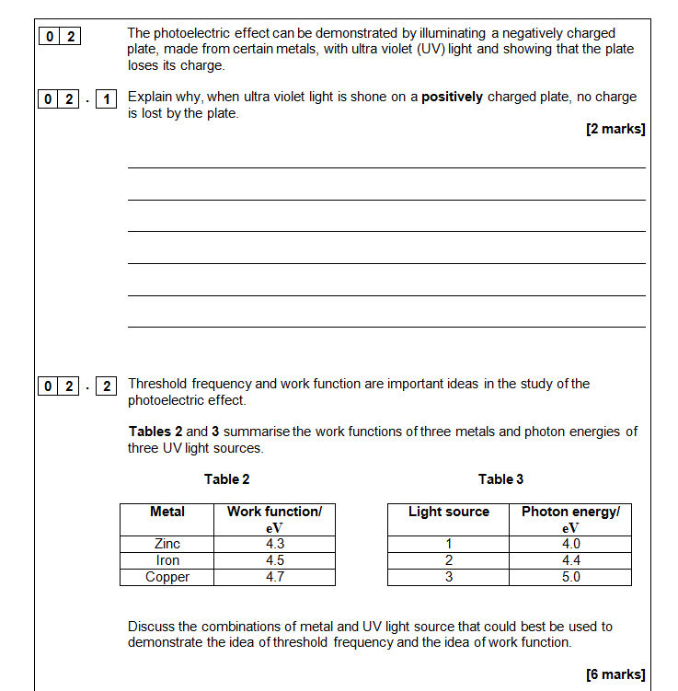
Familiar exemplars - 1
Essay style question, AS Paper 1, Q2
Slide 40
Copyright © AQA and its licensors. All rights reserved.
Copyright © AQA and its licensors. All rights reserved.

Slide 41
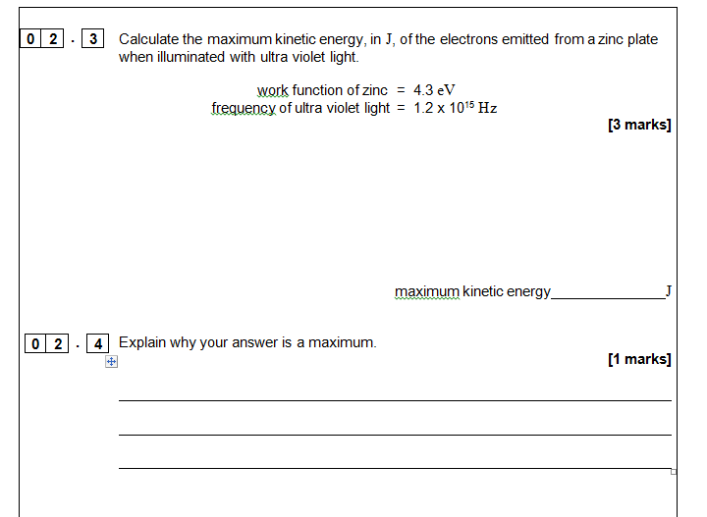
Familiar exemplars - 1
Essay style question, AS Paper 1, Q2
Slide 41
Copyright © AQA and its licensors. All rights reserved.
Copyright © AQA and its licensors. All rights reserved.

Slide 42
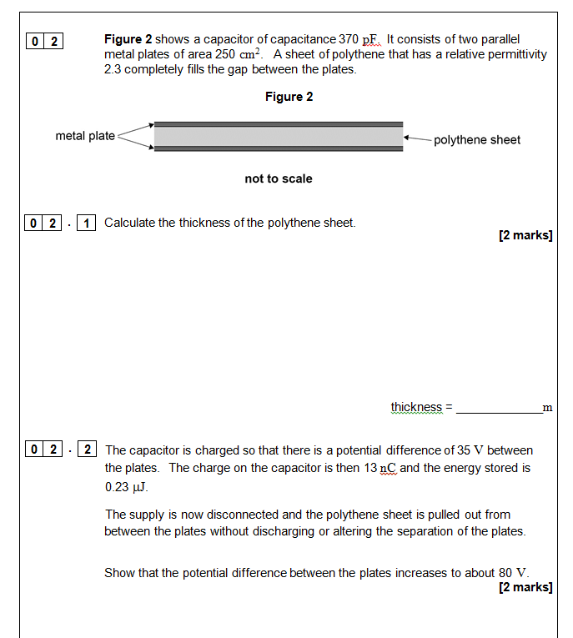
Familiar exemplars - 1
Structured question, A-level Paper 2, Q2
Slide 42
Copyright © AQA and its licensors. All rights reserved.
Copyright © AQA and its licensors. All rights reserved.

Slide 43
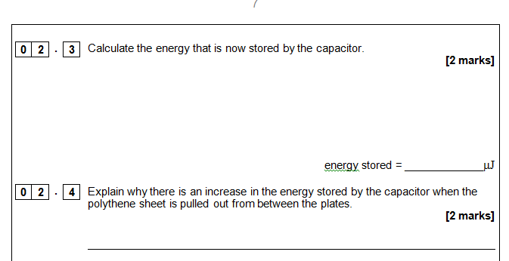
Familiar structure exemplars – 1
Structured question, A-level Paper 2, Q2
Slide 43
Copyright © AQA and its licensors. All rights reserved.
Copyright © AQA and its licensors. All rights reserved.

Slide 44
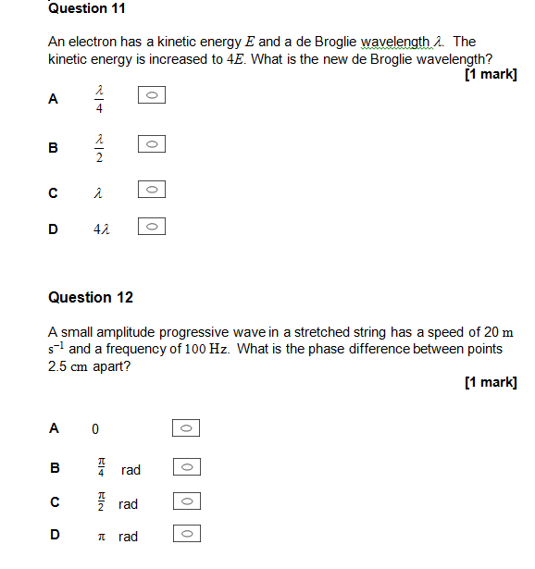
Familiar structure exemplars - 2
Multiple choice questions, A-level Paper 1, Q11 and Q12
Slide 44
Copyright © AQA and its licensors. All rights reserved.
Copyright © AQA and its licensors. All rights reserved.

Slide 45
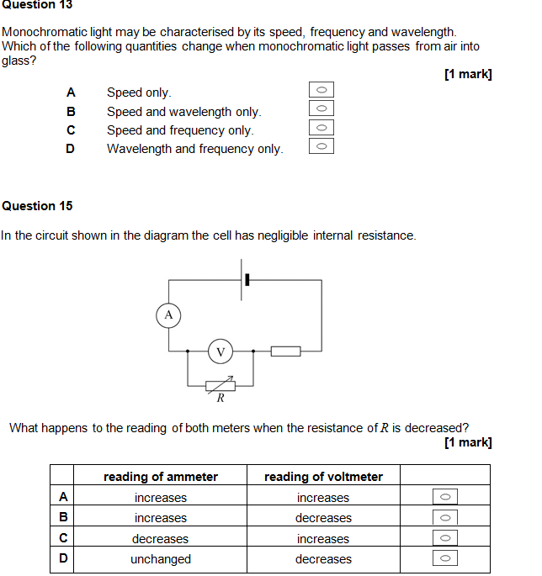
Familiar structure exemplars - 2
Multiple choice questions, A-level Paper 1, Q13 and Q15
Slide 45
Copyright © AQA and its licensors. All rights reserved.
Copyright © AQA and its licensors. All rights reserved.

Slide 46
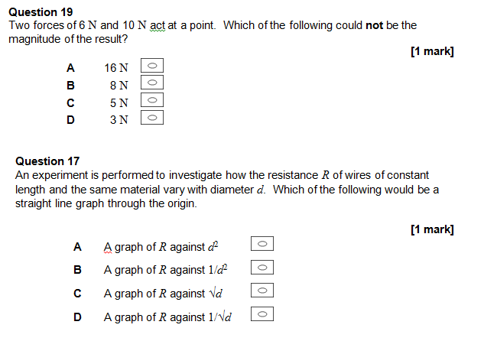
Familiar structure exemplars - 2
Multiple choice questions, A-level Paper 1, Q19 and Q17
Slide 46
Copyright © AQA and its licensors. All rights reserved.
Copyright © AQA and its licensors. All rights reserved.
Notes:
.

Slide 47
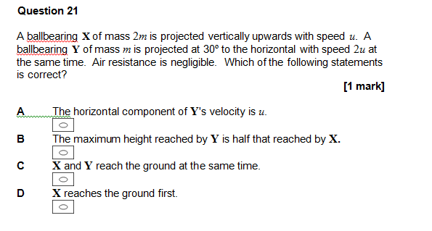
Familiar structure exemplars - 2
Multiple choice question, A-level Paper 1, Q21
Slide 47
Copyright © AQA and its licensors. All rights reserved.
Copyright © AQA and its licensors. All rights reserved.

Slide 48
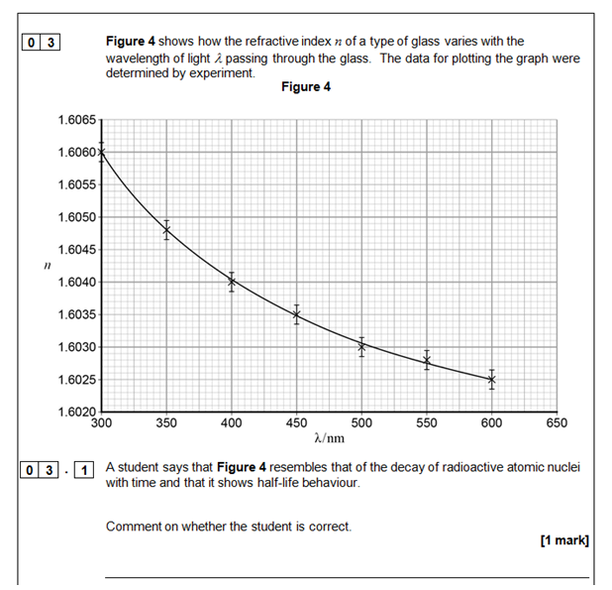
Familiar structure exemplars - 3
ISA and EMPA style question in written paper context
A-Level Paper 3, Question 3, Refractive index
Slide 48
Copyright © AQA and its licensors. All rights reserved.
Copyright © AQA and its licensors. All rights reserved.

Slide 49
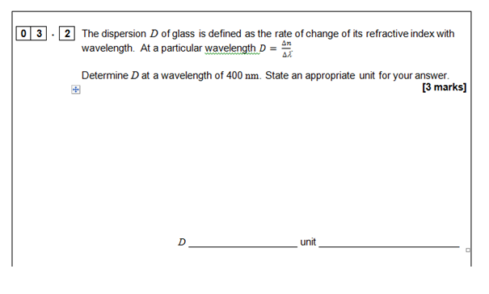
Familiar structure exemplars – 3
A-Level Paper 3, Question 3, Refractive index
Slide 49
Copyright © AQA and its licensors. All rights reserved.
Copyright © AQA and its licensors. All rights reserved.

Slide 50
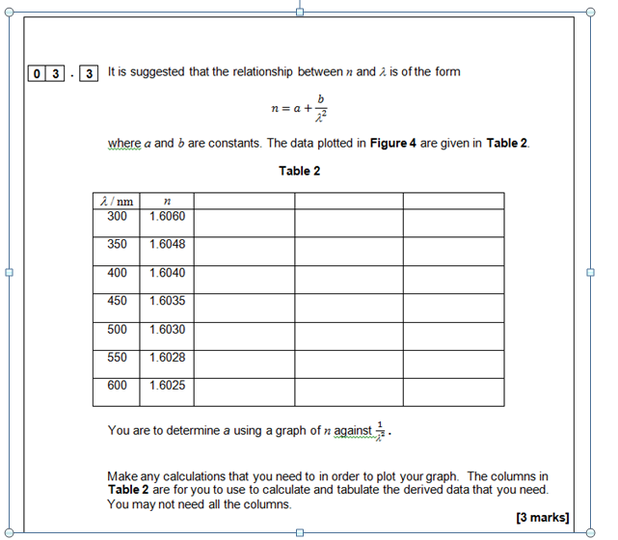
Familiar structure exemplars - 3
A-Level Paper 3, Question 3, Refractive index
Slide 50
Copyright © AQA and its licensors. All rights reserved.
Copyright © AQA and its licensors. All rights reserved.

Slide 51
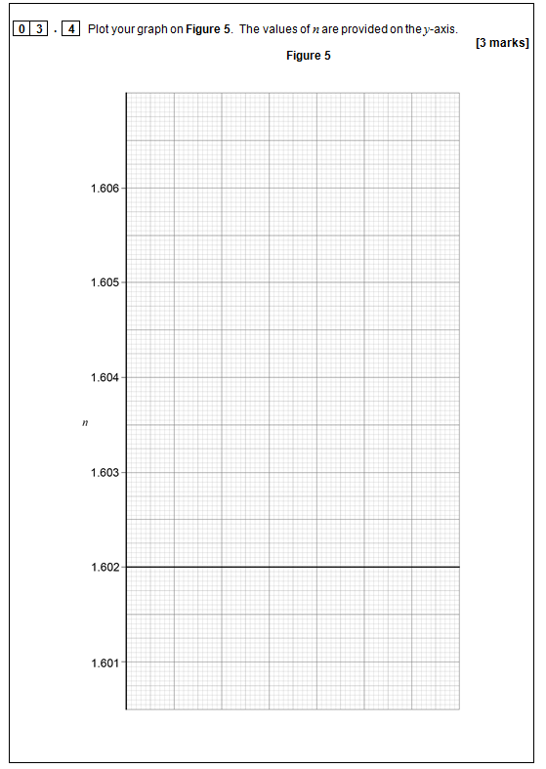
Familiar structure exemplars - 3
A-Level Paper 3, Question 3, Refractive index
Slide 51
Copyright © AQA and its licensors. All rights reserved.
Copyright © AQA and its licensors. All rights reserved.

Slide 52
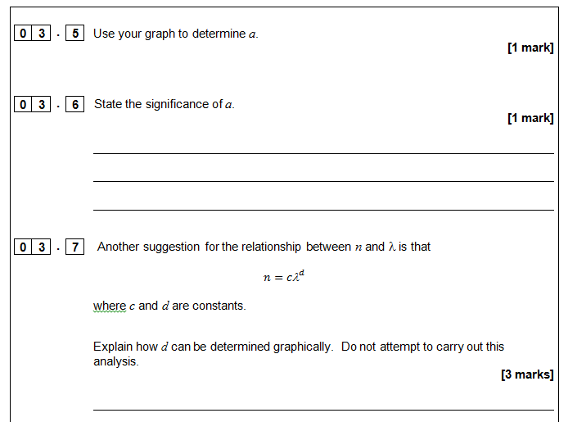
Familiar structure exemplars - 3
A-Level Paper 3, Question 3, Refractive index
Slide 52
Copyright © AQA and its licensors. All rights reserved.
Copyright © AQA and its licensors. All rights reserved.

Slide 53
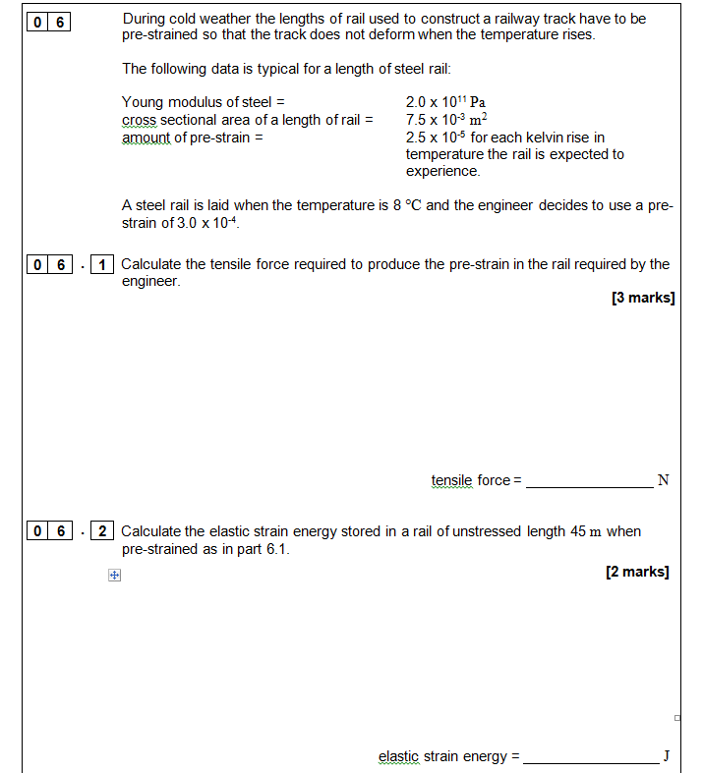
New style exemplars - 4
AS Paper 1, Question 6 extended stem question
Slide 53
Copyright © AQA and its licensors. All rights reserved.
Copyright © AQA and its licensors. All rights reserved.

Slide 54
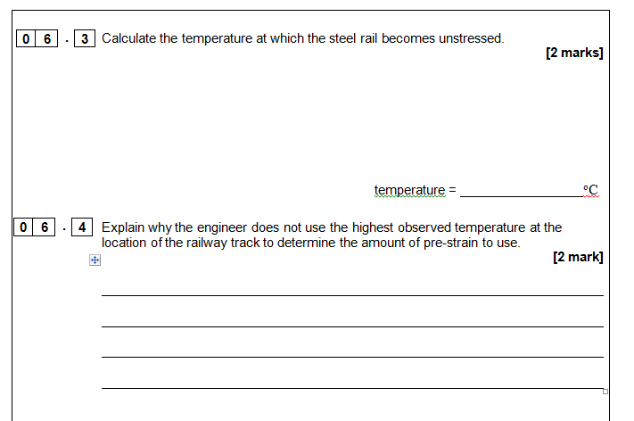
New style exemplars - 4
AS Paper 1, Question 6 extended stem question
Slide 54
Copyright © AQA and its licensors. All rights reserved.
Copyright © AQA and its licensors. All rights reserved.

Slide 55
Required practicals - 1
Slide 55
Copyright © AQA and its licensors. All rights reserved.
Copyright © AQA and its licensors. All rights reserved.

Slide 56
Required practicals - 2
Slide 56
Copyright © AQA and its licensors. All rights reserved.
Copyright © AQA and its licensors. All rights reserved.

Slide 57
5 Competencies – common to all boards
Follows written procedures
Applies investigative approaches and methods when using instruments and equipment
Safely uses a range of practical equipment and materials
Makes and records observations
Researches, references and reports
Slide 57

Slide 58
Endorsement – all boards
Competencies (Common Practical Assessment Criteria) – assessed by the teacher for endorsement
  Pass or not reported
Consistency - details of administration will be common to all boards
AQA is very aware that record keeping and moderation needs to be a workable process, that is not onerous on schools
Awarding bodies have made recommendations to Ofqual and boards will be running trials in the autumn term, could involve:
  monitoring teaching plans/student logs
  monitoring teacher assessment
  student interviews
Final details due Spring 2015. Make sure you’re using the final version of the specifications.
Slide 58

Slide 59
Questions
Slide 59
Copyright © AQA and its licensors. All rights reserved.
Copyright © AQA and its licensors. All rights reserved.

Slide 60

AQA ongoing support and resources
Slide 60
Copyright © AQA and its licensors. All rights reserved.
Copyright © AQA and its licensors. All rights reserved.

Slide 61

AQA ongoing support and resources
AQA website
e-AQA
Secure Key Materials
ERA (Enhanced Results Analysis)
Training courses
Free Preparing to teach events (Spring 2015)
Slide 61
Copyright © AQA and its licensors. All rights reserved.
Copyright © AQA and its licensors. All rights reserved.

Slide 62
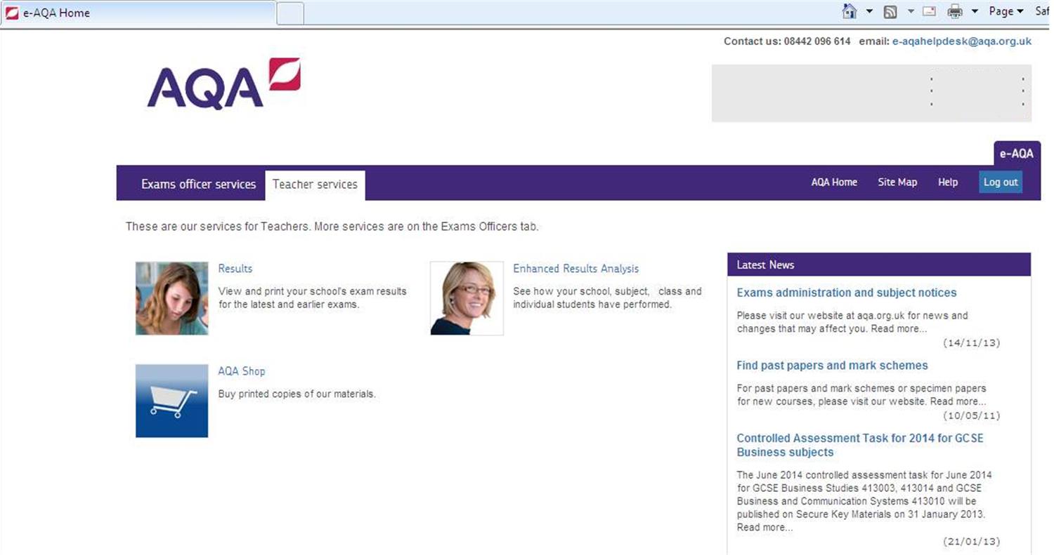
e-AQA
Slide 62
Copyright © AQA and its licensors. All rights reserved.
Copyright © AQA and its licensors. All rights reserved.

Slide 63
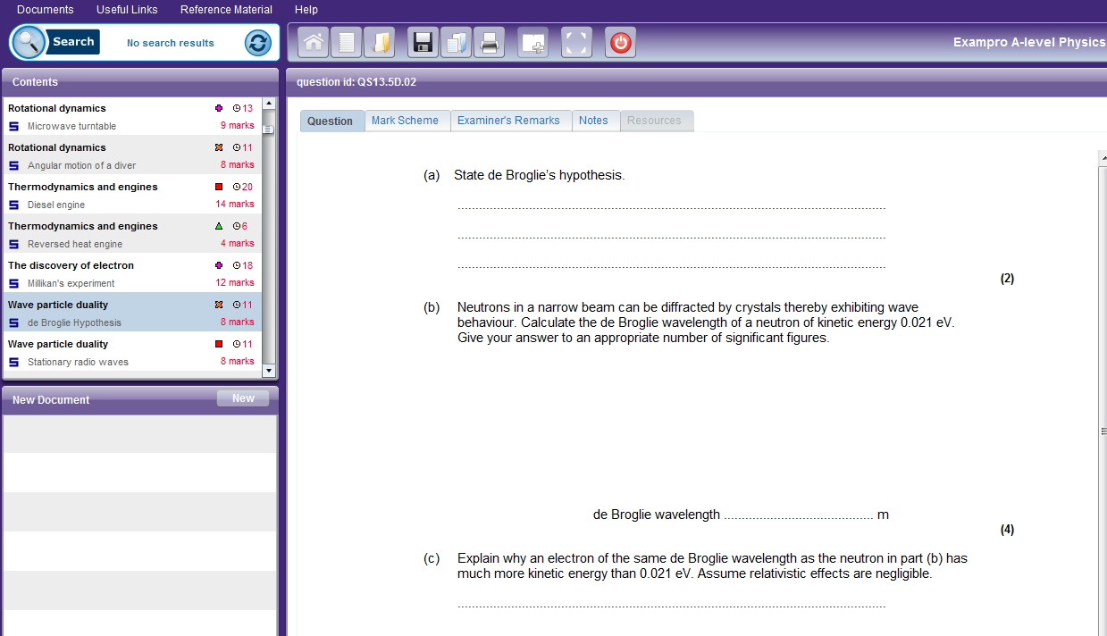
Exampro – option to buy additional resources
Cost: £80 - every licence includes three concurrent users so any three teachers can use each database simultaneously but you can order additional users at any time.
Slide 63
Copyright © AQA and its licensors. All rights reserved.
Copyright © AQA and its licensors. All rights reserved.

Slide 64
Timeline 1
Draft Specification and specimen question papers, and mark schemes published
First teaching of AS/A-level in Physics
Accredited Specification published
Teacher training courses available
Free Preparing to Teach events
Free Introductory events online
and face to face
Teacher and learner resources published
Jun 14
Sep14
Dec 14
Mar 14
Jun 15
Sep 15
Slide 64
Copyright © AQA and its licensors. All rights reserved.
Copyright © AQA and its licensors. All rights reserved.

Slide 65
Contact points for more information and guidance
For further questions contact our Customer Support Managers
Contact details for A-level Science:
science-gce@aqa.org.uk
Tel no: 01483 47 7756
Slide 65
Copyright © AQA and its licensors. All rights reserved.

Slide 66
Final questions
Slide 66
Copyright © AQA and its licensors. All rights reserved.
Follow us on Twitter @AQACPD.

Slide 67
Thank you
We are an independent education charity
and the largest provider of academic qualifications for all abilities taught in schools and colleges.
Our aim is to enable students to realise their potential
and provide teachers with the support and resources they need
so that they can focus on inspiring learning.
aqa.org.uk
Follow us on Twitter @AQACPD.

